Slide 1
Winterization Strategy 2024-25 Shelter NFIs & CCCM Sector Pakistan
October 2024

Slide 2
Agenda
PAKISTAN
Context
Winterization 2024 / 25 Needs
Target Districts and Criteria
Winterization Approaches
Shelter Priorities for Winterization
Shelter / NFI / CCCM Sector Preparedness
Winterization Coverage and Gap
Gap and Financial Ask

Slide 3
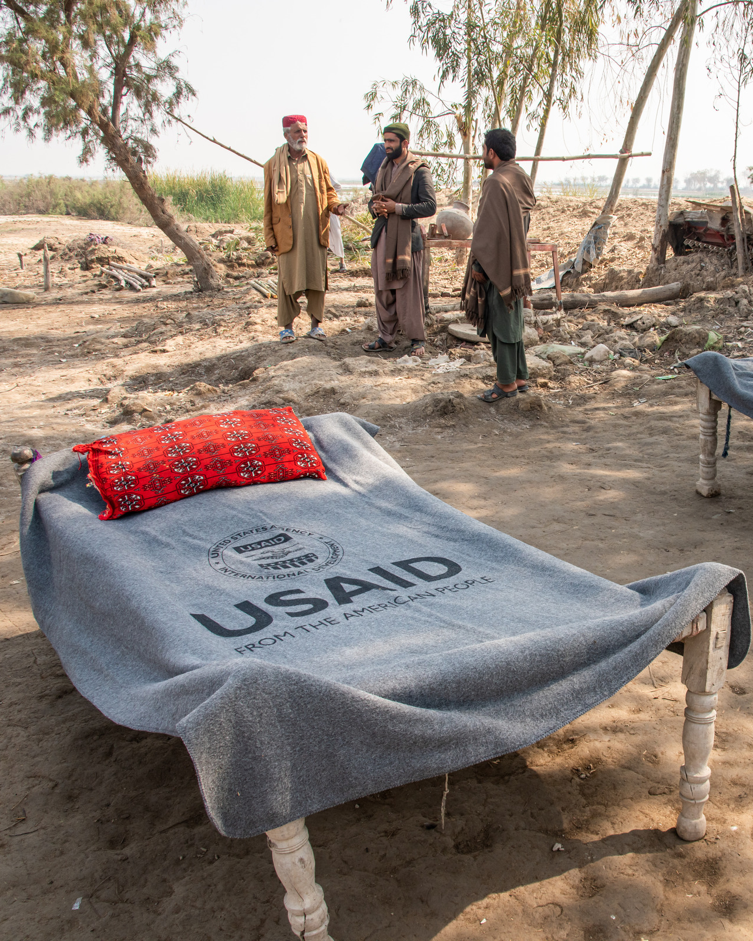
Context
PAKISTAN
Winterization is primarily related to cold weather, especially in Northern and Northwestern regions, though hazards also include rain and snowfall, blizzards, avalanches, and fog.
Winter assistance is particularly needed in flood-affected districts and those districts most exposed to cold weather
Winterization Strategy advocates for an immediate response to these needs and provides recommendations on minimum winterization standards.
High priority items* including blankets, quilts, shawls, mattress, and sleeping mats
Lower priority items* including fuel efficient stoves, warm clothes, and tarpaulins
*according to 2022 Winterization plan, approved by PDMA

Slide 4
Target Districts and Criteria
PAKISTAN
Province ​ | Prioritized Districts ​(by SNFI Sector) | Criteria ​
Sindh​ | Sanghar, Umerkhot, Mirpurkhas, Dadu, Badin, Qamber Shahdadkot, Khairpur, Matiari, and Jacobabad | Districts affected by 2022/23/24 floods and prone to cold weather and/or not yet receiving assistance. Areas that will most likely have extreme weather condition (snow bound areas i.e., North and Northwestern parts of country) ​ Districts that are inaccessible in winters hard to reach area due to snow or bad roads.​ Poverty.​
KPK​ | KP - Chitral Upper, Chitral Lower, Kohistan Upper, Upper Mansehra, Upper Swat, Shangla, Dir Upper, Kohistan Lower Merged districts of KP - Tirah District, Khyber, Upper South Waziristan, Wazistan North, Orakzai, Kurram
Balochistan​ | Flood-affected: Ziarat and Kalat Cold: Pishin, Zhob, Kach, Chaghi
Punjab​ | Rajanpur, Dera Ghazi Khan ​
Kashmir | Muzaffarabad, Jehlum Valley, Neelum, Poonch, Bagh, Havelli, Sudhnoti, Mirpur
Gilgit Baltistan​ (2023) | Ghizar, Ghanche, Astoor, Diamar, Skardu, Upper Hunza​, Shigar, Nagar, Kharmang

Slide 5
Options for Shelter Winterization
PAKISTAN
Provision of essential household items to the most vulnerable households.
Shelter improvements to prevent heat loss from shelters/homes
Provision of stoves to the most vulnerable households in the targeted locations.
Dissemination of PMD / DMA advisories, including key messages
Support to protect livestock from cold weather

Slide 6
PAKISTAN
Winterization Approaches in Pakistan
To maximize assistance and protection from harsh cold weather for those in need, the Winterization Strategy advocates that the following three approaches be undertaken simultaneously
1. Distribution of NFIs
Sector partners to ensure distribution of available winter kits before severe cold weather starts, and to ensure timely procurement of kits to expand coverage in a timely manner.
The approved Winter Kit includes 2 double blankets/quilts, 2 adult shawls, 4 children’s shawls, and 1 cotton mattress.
This is the primary winterization activity in Pakistan. Some stocks / funding are in place, but large gaps remain.
2. Provision of winterized Transitional Shelter or Shelter Improvement support
Partners with winterized shelters stocks, capacity, access and experience are asked to focus on snow bound areas e.g., Chitral, and districts in GB & AJK for timely provision of shelters.
This has been included in the Winterization strategy for many years but is not prioritized for funding, unless there is significant displacement.

Slide 7
Shelter/NFI/CCCM Sector Preparedness
PAKISTAN
Winter Strategy 2024/25 developed in October at National level and presented at ISWG (18 Oct). It will also be shared with the key stakeholders including partners, Government, N/PDMAs after HCT endorsement.
Information management and data sharing sector is compiling updated information and data through utilization of various tool including 5W matrix, dedicated winter stocks and partners mapping to avoid duplication and identify the most vulnerable, at risk and affected areas.
Winter coordination meeting and partners mobilization bilateral and sector meetings conducted at National and Provincial levels, 22 partners have shown interest in terms of resources, preparedness, and access. Coordination meetings were jointly organized by IOM & OCHA with PDMAs. Stock mapping with PDMAs, SDMA (AJK) and GBDMA was carried out.
Partners and stocks mapping completed along with contingencies and availability of winterization stocks available. Areas with minimum assistance and lack of partners have been identified, and sector is advocating to mobilize partners
Technical guidelines for winterization developed including details and specification of winter kit and shelter kits.
Early warning: The sector will share early warnings received from PMD and N/PDMA on regular basis with partners through winter season.

Slide 8
Sector Caseload
PAKISTAN
Provinces | Total Caseload* |  | Sector Target** |  | Coverage by PDMAs/ SDMA/GBDMA
 | # of households | # of people | # of households | # of people
Balochistan | 24,006 | 168,041 | 7,202 | 50,412 | No information on PDMA stocks
Khyber Pakhtunkhwa | 2,254 | 15,778 | 2,254 | 15,778 | Winterization kits for 6000 HH in pipeline
Sindh | 53,189 (PDMA prioritized Districts only) | 372,323 | 15,957 | 111,697 | No winterization kits available in stocks, only blankets
Punjab | 10,146 | 71,022 | 3,044 | 21,307 | No winterization kits available only tents
Gilgit-Baltistan | 2,000 | 14,000 | 1,500 | 10,500 | Capacity for 500 HH coverage available
Kashmir | 12,170 | 85,190 | 3,651 | 25,557 | Winterization kits for 26 HH available
Total |  | 726,354 | 33,607 | 235,251
* This is based on the 2024 flood-affected population only. Therefore, this is an underestimate of actual winterization needs. ** Sector target is kept at 30% of the total affected population except for GB and KPK due to minimal caseload

Slide 9
Winterization - Sector Coverage and Gap
PAKISTAN
S.No | Items | Stocks | Households | Individuals | Gap (HHs)
1 | Blankets | 10,855 | 1,550 | 10,855
2 | Quilts | 3,175 | 453 | 3,175
3 | Warm Clothes | 16,900 | 2,414 | 16,900
4 | Winter kits | 12,980 | 12,980 | 12,980 | 20,627
5 | Stoves | 3,820 | 3,820 | 26,740
6 | Sleeping Mats | 1,600 | 229 | 1,600
 | Total |  | 17,973 | 125,810
Total 22 organizations responded in total.
Additionally, KSRelief plan to provide 25,000 winter kits under ‘Shelter NFIs and Winter Kits Project Pakistan for 2024-25’. The project is currently awaiting final approval from head office.

Slide 10
Winter_Contingency_Stock_Mapping_2024-25
Organization Name: | Stock Location: | Number of Sleeping Mats: | Number of Quilts: | Number of Warm Cloth: | Number of Winter Kit: | Number of Stoves: | Number of Blankets:
Muslim Hands | Rawlakot, Kashmir |  |  |  | 600
 | Swat-KP |  |  |  | 300
 | Ziarat & Kan mehtarzai, Baluchistan |  |  |  | 300 |  | 1600
Muslim Aid | Chitral (upper & lower) KPK | 1600 |  | 800 | 800
National Integrated Development Association (NIDA-Pakistan) | Lower Chitral (will be procuring and will distribute in November 2024) |  |  | 400 | 200 |  | 200
Al Noor Welfare Organization | Sindh Larkana U/C Rasheed Wagan |  |  | 70 |  | 70 | 70
Al Ubed Welfare Association | Sindh Jacobabad |  |  | 100
Alisha Women Development Society | Sindh Kamber shahdadkot, dadu larkana |  |  |  | 450
Alkhidmat foundation | Sindh Sukkur & Matiari |  | 125 |  |  |  | 75
Alliance of the Civil Society for Human Rights (ACSHR) | Sindh Dadu |  | 50 | 50
AMRDO FOUNDATION-AF | Hyderabad Sindh Pakistan |  |  |  | 1000
 | Sindh New Saeedabad District Matiari |  |  | 2500 | 1000 | 1000 | 1000
Association For Nations Development A N D | Jacobabad Sindh Pakistan |  | 1000 | 1000 | 1000 | 1000 | 1000
Badin Development Organization | Sindh Badin |  |  | 100

Slide 11
Winter_Contingency_Stock_Mapping_2024-25
Organization Name: | Stock Location: | Number of Sleeping Mats: | Number of Quilts: | Number of Warm Clothes: | Number of Winter Kit: | Number of Stoves: | Number of Blankets:
Indus Community empowerment Foundation (ICEF) | Sindh Sukkur |  |  | 150 |  |  | 100
Islamic Relief | Procurement process in progress |  |  | 430 | 430 |  | 430
 | Punjab Rajanpur Not yet confirmed |  |  |  | 1200
Khubaib Foundation | Islamabad |  |  | 10000 |  | 750 | 4500
Manzil Organization Balochistan | Quetta and Sibi Baluchistan |  |  | 300 | 300 |  | 300
Qatar Charity | 500 winterization kits proposed however its not confirmed funding |  | 500 |  | 500
 | Islamabad |  |  |  | 2000
Sadia | During emergency we make appeal share with our donors after that we response |  |  |  |  |  | 80
Shifa Foundation | Sindh Mattari |  | 500 |  | 500 |  | 500
SRDP Sindh | Sindh Shikarpur |  |  |  | 100
Women and Youth's development organization | Sindh Jamshoro |  |  |  | 100
Women Children Welfare Association | Sindh UC Qadir Purr District Jacobabad |  | 1000 | 1000 | 1000 | 1000 | 1000
Zahir Qadir | will procure as needed during the emergency and will respond within 72 hours |  |  |  | 1200
Grand Total |  | 1,600 | 3,175 | 16,900 | 12,980 | 3,820 | 10,855

Slide 12
Winterization – Stocks Available with PDMAs
PAKISTAN
S.NO | ITEMS/DESCRIPTION | Present QTY | In Pipeline | Stock + Pipeline | # people | # Household | Remarks
PDMA Sindh
1 | Blankets | 258,425 | 0 | 258,425 | 258,425 | 36,918 | Karachi: 25,842 Jamshoro: 11,6291 Sukkur: 11,6291
PDMA Punjab
1 | Tent | 2,100 | - | 2,100 | 14,700 | 2,100 | DG Khan warehouse: 1,900 Rajanpur warehouse: 200
Note: | Required stocks for Punjab prioritized districts; in DG Khan - 2000 blankets, 500 mattress, 3000 warm clothing in Rajanpur - 5000 tents, 1400 blankets, 2354 warm clothing and 800 mattress are required
PDMA Balochistan
Note: | The date on available stocks is still awaited.
S.NO | ITEMS/DESCRIPTION | Present QTY | In Pipeline | Stock + Pipeline | # people | # Household | Remarks
PDMA Khyber Pakhtunkhwa
1 | Winterize Tent | 0 | 6000 | 6000 | 42,000 | 6,000 | *table includes items in pipeline
2 | Blankets | 39381 | 0 | 39381 | 39,381 | 5,626
5 | Mattress | 180 | 11000 | 11180 | 11,180 | 1,597
6 | Quilts | 1312 | 10000 | 11312 | 11,312 | 1,616
7 | Mats | 14956 | 5000 | 19956 | 19,956 | 2,851
8 | Pillows | 843 | 10000 | 10843 | 10,843 | 1,549
9 | Sleeping Bags | 60 | 10000 | 10060 | 10,060 | 1,437
10 | Gas Cylinder | 50 | 0 | 50 | 350 | 50
11 | Oil Burner / Stove | 437 | 0 | 437 | 3,059 | 437
12 | Sweaters | 2000 | 0 | 2000 | 2,000 | 286
13 | Jackets (Jarsi) | 100 | 0 | 100 | 100 | 14
14 | Shawl | 685 | 0 | 685 | 685 | 98

Slide 13
Winterization – Stocks Available with SDMA and GBDMA
PAKISTAN
S.NO | ITEMS/DESCRIPTION | Present QTY | In Pipeline | Stock + Pipeline | # people | # Household | Warehouse/Location
SDMA - Azad Jammu & Kashmir
1 | Winterized Tent | 26 | - | 26 | 182 | 26 | Available stocks at central warehouse and 10 district warehouses in Muzaffarabad, Neelum, Jehlum Valley, Poonch, Bagh, Bhimber, Sudhunuti, Kotli, Mirpur, Haveli)
2 | Blanket | 601 | - | 601 | 601 | 86
3 | Mattress | 632 | - | 632 | 632 | 90
4 | Quilts | 3,149 | - | 3,149 | 3,149 | 450
5 | Plastic Mats | 1,299 | - | 1,299 | 1,299 | 186
6 | Sleeping Bags | 135 | - | 135 | 135 | 19
7 | Plastics Sheets | 1,824 | - | 1,824 | 12,768 | 1,824
8 | CGI Sheets | 800 | - | 800 | 5,600 | 800
9 | Kitchen Set | 1,225 | - | 1,225 | 8,575 | 1,225
10 | Bed Talai | 719 | - | 719 | 719 | 103
11 | Tent | 1,358 | - | 1,358 | 9,506 | 1,358
GBDMA official notification states that;
A critical situation is likely to be faced by approximately 2,000 families in various snow-bound areas across Gilgit-Baltistan during winters. Due to heavy snowfall, many remote regions get cut off from essential services and supplies during the winter season, leaving these families vulnerable to food and other supply shortages.
GBDMA is currently equipped to provide relief items for only 500 families.
In case if the demand exceeds this capacity, we will require additional support to respond effectively to the needs of the remaining families.

Slide 14
Summary
PAKISTAN
Over 100,000 households affected by 2024 in need of support:
Sindh: 53,189 HHs
Balochistan: 24,006 HHs
Kashmir: 12,170 HHs
Punjab: 10,146 HHs
KP: 2,254 HHs
Primary means of support is provision of Winter NFIs
PDMAs have available stocks for approx. 45,000 households
Sector partners have stock for 12,980 HHs, compared to a caseload of 33,607 HHs
Gap = 20,627 HHs
Ask = $1,650,160

Slide 15
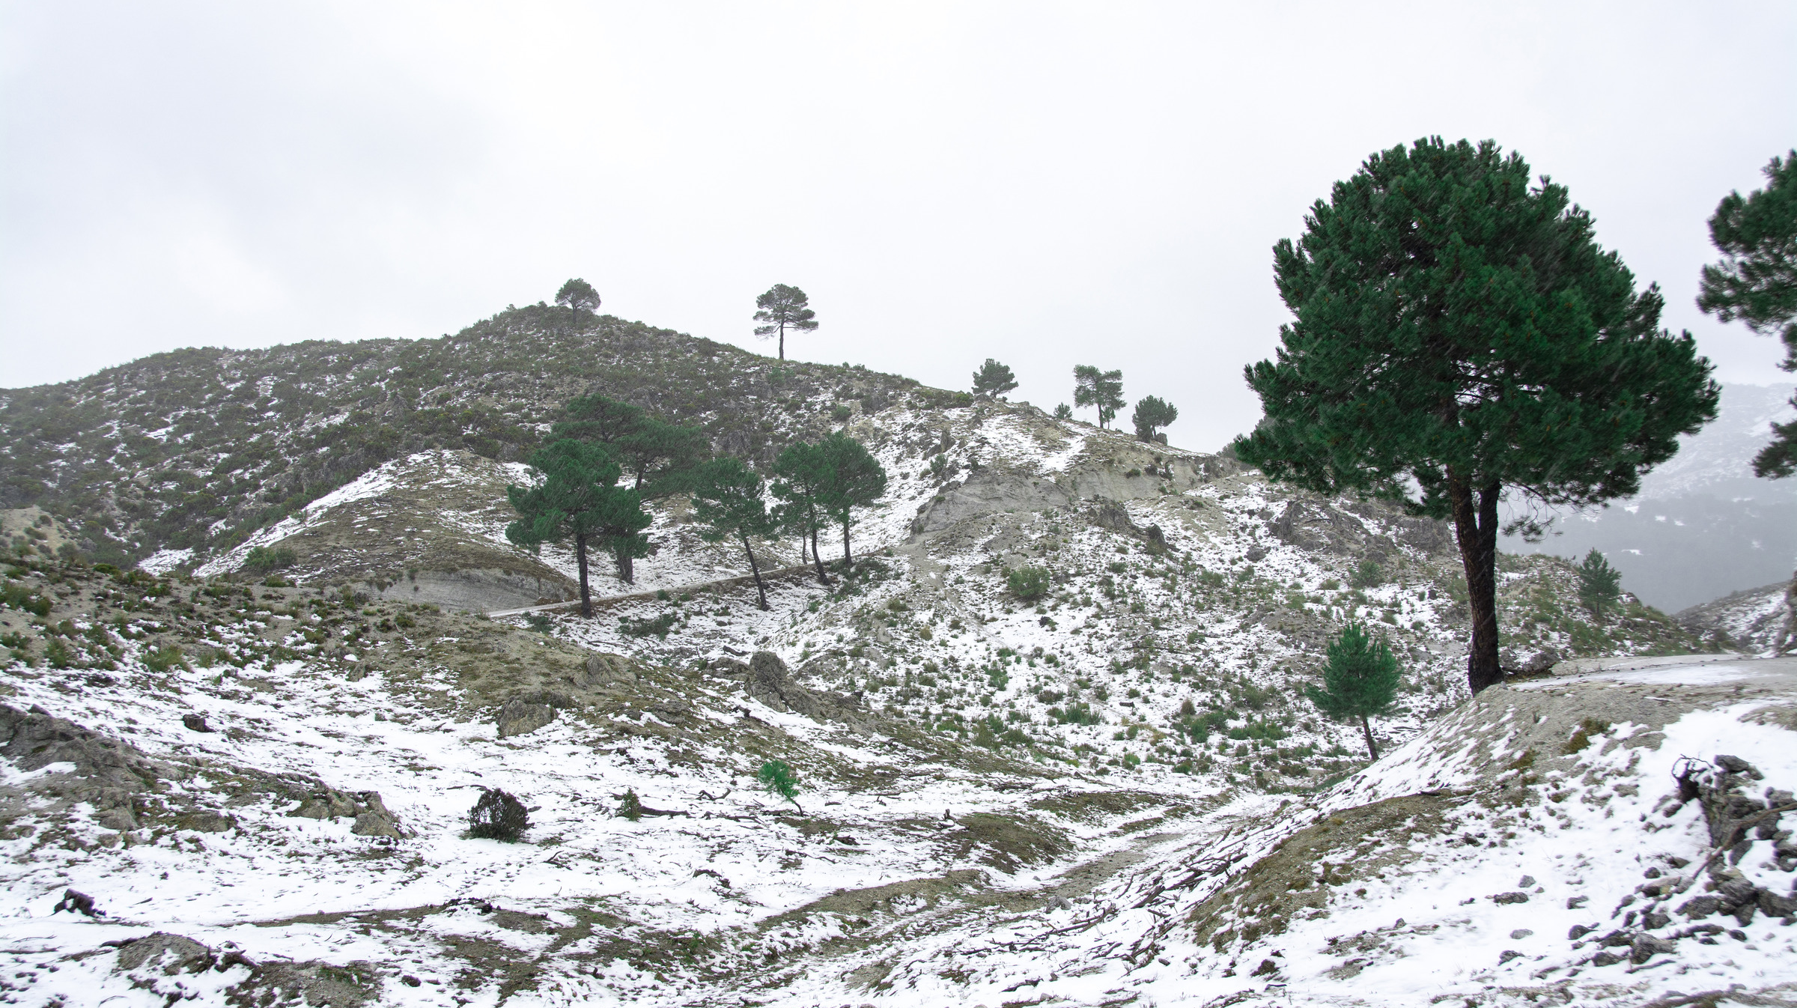
Thank You!

