Slide 1
Flood Impact Assessment Report - August 2024
WOMEN CHILDREN WELFARE ASSOCIATION
Abdul Rasheed (CEO-WCWA)
info@wcwa.org.pk
03337351625
03009257271

Slide 2
Overview
The Women Children Welfare Association (WCWA) has conducted a detailed assessment of the recent floods in District Jacobabad, focusing on various Union Councils (UCs) heavily impacted by the monsoon rains. This report highlights the extent of damage to rice crops, livestock, houses, and infrastructure, supported by photographic evidence

Slide 3
Affected Union Councils and Villages
1. UC Qadir Pur & Shah Pur:
Villages: Qadir Pur, Sardar Muqeem Khan Khoso, Qadir Khan, Fatih Pur, Ali Hassan Zawrani, Nabidad Zawrani, Abdul Qadir Zawrani, Qubo Raheem, Akram Khoso, Balel Village, Ali Muhammad Korar, Khaloolabad, Naich Goth, Nodhkani Goth, Tarique Khan, Shahque Khoso, Ghulab Mastoi, Mola Bux, Shahani Goth, Atta Muhammad Khoso, Jamak Khoso.

Slide 4
Affected Union Councils and Villages
UC SHAH PUR (Deh Shajarr)
1. Hajji Mola Bux Khoso
2. Abdul Rahman Khoso
3. Mazar Golo
4. Shajarr
5. Bhai Khan Buledi
6. Nazr Muhammad Dostlani
7. Raes Sattar Pandhyani
8. Raja Abdul Raheem Khoso
9. Mola Bux Pandhiyani

Slide 5
Affected Union Councils and Villages
UC SHAH PUR (Deh Bajhani)
1. Wada Bajhani
2. Mahboob Bajhani
3. Soomra Waahi
4. Rind Goth
5. Daim
6. Nazeer Hussain Mugeri
7. Rustum Mugeri
8. Khuda Bux Mugeri
9. Gulbahar Bajhani
10. Ghulam Ali Bajhani
11. Umrah Goth
12. Hazoor Bux Mugeri
13. Bahadur Mugeri
14. Raheem Khan
15. Karam Khan Mugeri

Slide 6
Affected Union Councils and Villages
UC SHAH PUR (Deh Retti)
1. Rahamat Pur
2. Retti
3. Bachal Khoso
4. Hajji Khan
5. Pahalwan
6. Ali Hassan
7. Din Muhammad
8. Muhammad Alam
9. Bakhsh Ali
10. Menho Khan

Slide 7
Affected Union Councils and Villages
UC SHAH PUR (Deh Orangabad)
1. Oranagabad
2. Khosa Goth
3. Ali Gohar Khoso
4. Nobat Khoso
5. Abdul Raheem Khan
6. Janan Khoso
8. Kamal Shah
9. Tarique Khan Khoso
10. Shero Shahar

Slide 8
Affected Union Councils and Villages
2. UC Ramzan Pur Deh:
Villages:
Deh 01:
1. Ramzan Pur
2. Meer Hazar Khan Bhayo
3. Meer Allah Yaar Khan
4. Meer Gada Ali Khan
5. Meer Shahryar Khan
6. Meer Ashique Ali
7. Meer Ahmed Yaar
8. Haji Lotu Brohi
9. Ghulam Hyder Sadhayo
10. Shahbaan Soomro
11. Bahadur Mugheri
12. Rodin Brohi
13. Gous Bux Brohi

Slide 9
Affected Union Councils and Villages
Deh 02: Fatha Pur Villages
1. Meer Asghar Ali Bhayo
2. Saleem Pur
3. Sufi Muhammad Ayoob Rahoojo
4. Pepal Mashi
5. Raess Gull Bhayo
6. Akram Khan Thaheem
7. Buhram Mashi
8. Salman Mashi
9. Shahmeer Korejo
10. Muhammad Khan Umrani
11. Sikandar Brohi
12. Bhuri Brohi (Noor Hassan)
13. Mola Bux Brohi (Bahram Brohi)
14. Atur Lashari
15. Dad Muhammad Lashari (Photo Lashari, Allah Rakheyo)
16. Mahrab Brohi
17. Gous Bux Rahoojo
18. Khadim Korejo
19. Alim Pathan (Abdullah Pathan)
20. Asif Mugheri
21. Ali Nawaz Lashari
22. Sajan Khakherani

Slide 10
Affected Union Councils and Villages
Deh 03: Atti Villages
1. Atti
2. Changez Khan Bhayo
3. Mehran Khan Bhayo
4. Meer Amjad Ali Bhayo
5. Ahsanullah Bhayo
6. Ali Bux Umrani
7. Khan Umrani
8. Fazal Khoso
9. Leemo Khoso
10. Bagh Sanjrani
11. Hakeem Kehar
12. Dolat Brohi
13. Ahmed Khoso
14. Gulab Khoso

Slide 11
Affected Union Councils and Villages
Deh 04: Shahdad Pur Villages:
1. Amanullah Bhatti
2. Palyo Lashari
3. Rasheed Abbasi (Gul Bahar Brohi)
4. Muhammad Hassan Bhatti
5. Imam Bux Bhatti
6. Nabi Bux Brohi
7. Ghulam Rasool Brohi
8. Ameer Bux Brohi
9. Sahab Mashi (Saeed Khan Brohi)
10. Haji Hazoor Bux Umrani
11. Allah Dad Bhand
12. Mola Bux Ansari (Haji Mahar 01)
13. Noor Muhammad Brohi
14. Zagi Brohi
15. Mithal Brohi
16. Ghulam Rasool Kohri
17. Khadim Korejo
18. Asadullah Kalhoro

Slide 12
Affected Union Councils and Villages
Deh 05: Gous Pur Villages:
1. Mithal Khan Khoso
2. Jahangeer Khoso
3. Liaquat Khan Khoso
4. Mahboob Khan Khoso
5. Ghulam Nabi Khan Khoso
6. Jan Muhammad Khoso
7. Raju Weesar
8. Buhram Khoso
9. Molvi Qadir Bux Khoso
10. Sabzal Khoso
11. Ghulam Nabi Khan Umrani
12. Abdul Rasheed Maganhar

Slide 13
Affected Union Councils and Villages
Deh 06: Wakro Jagir Villages:
1. Pandhi Khoso
2. Sharbat Kakepoto
3. Ismail Kakepoto
4. Imam Bux Dayo
5. Ghulam Qadir Malano
6. Daim Khoso
7. Kisewai
8. Nawab Chandio
9. Malook Chandio
10. Atta Muhammad Chandio
11. Ahmed Khoso

Slide 14
Damage Assessment
Rice Crops: 20%-25% damage reported, affecting the primary source of livelihood in these areas.
Livestock: 5% loss, leading to further economic challenges for the affected communities.
Houses: 5%-10% structural damage, displacing many families and requiring urgent rehabilitation efforts.
Roads and Infrastructure: 15%-20% damage, disrupting connectivity and access to essential services.

Slide 15
Cause of Flooding
The flooding in these UCs is primarily due to heavy rainfall that caused overflow from the Kheerthar and Saif Ullah Canals, along with the Begari Canal. The stagnant water, with no proper drainage, accumulates in these UCs, which are low-lying areas. Additionally, the Sim Shakh from Baluchistan contributes to the overflow, further exacerbating the situation.

Slide 16
Conclusion…
The WCWA urges immediate attention to the affected areas to provide relief and rehabilitation. Measures such as improved drainage systems and better canal management must be implemented to prevent future occurrences of such devastating floods. The attached photographs provide visual evidence of the extent of the damage and the urgent need for intervention.

Slide 17
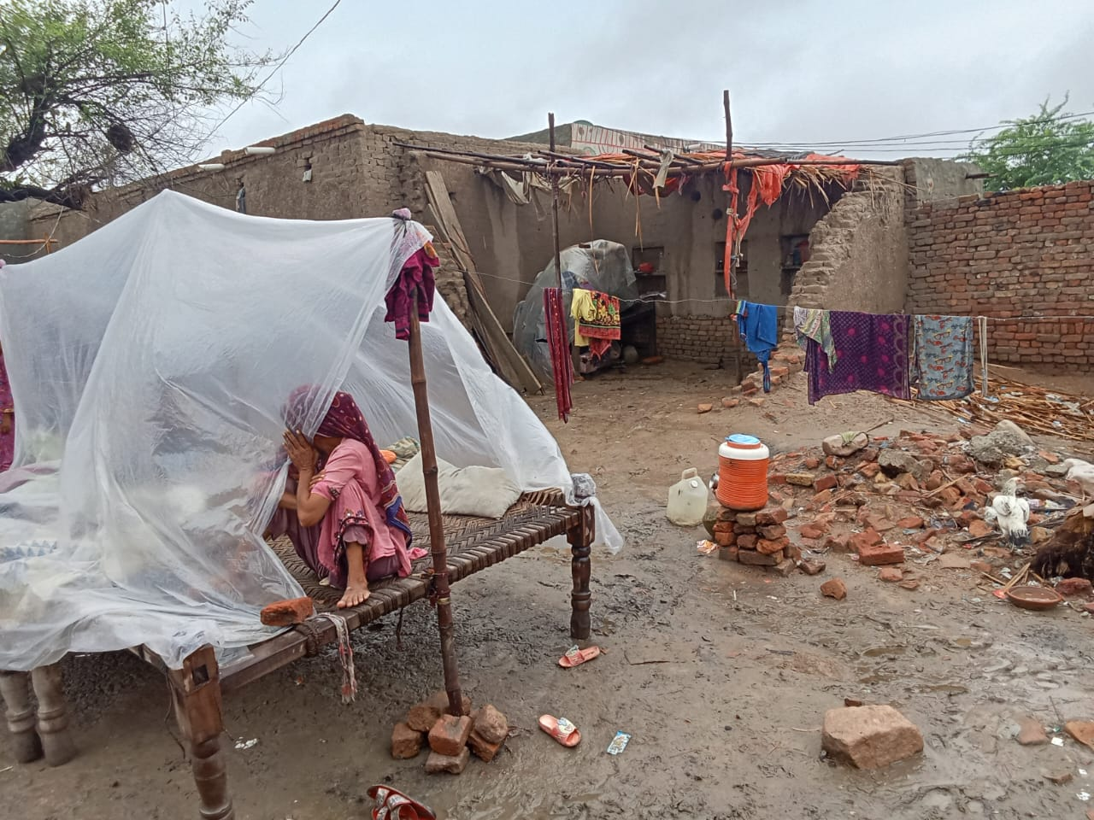
Images

Slide 18
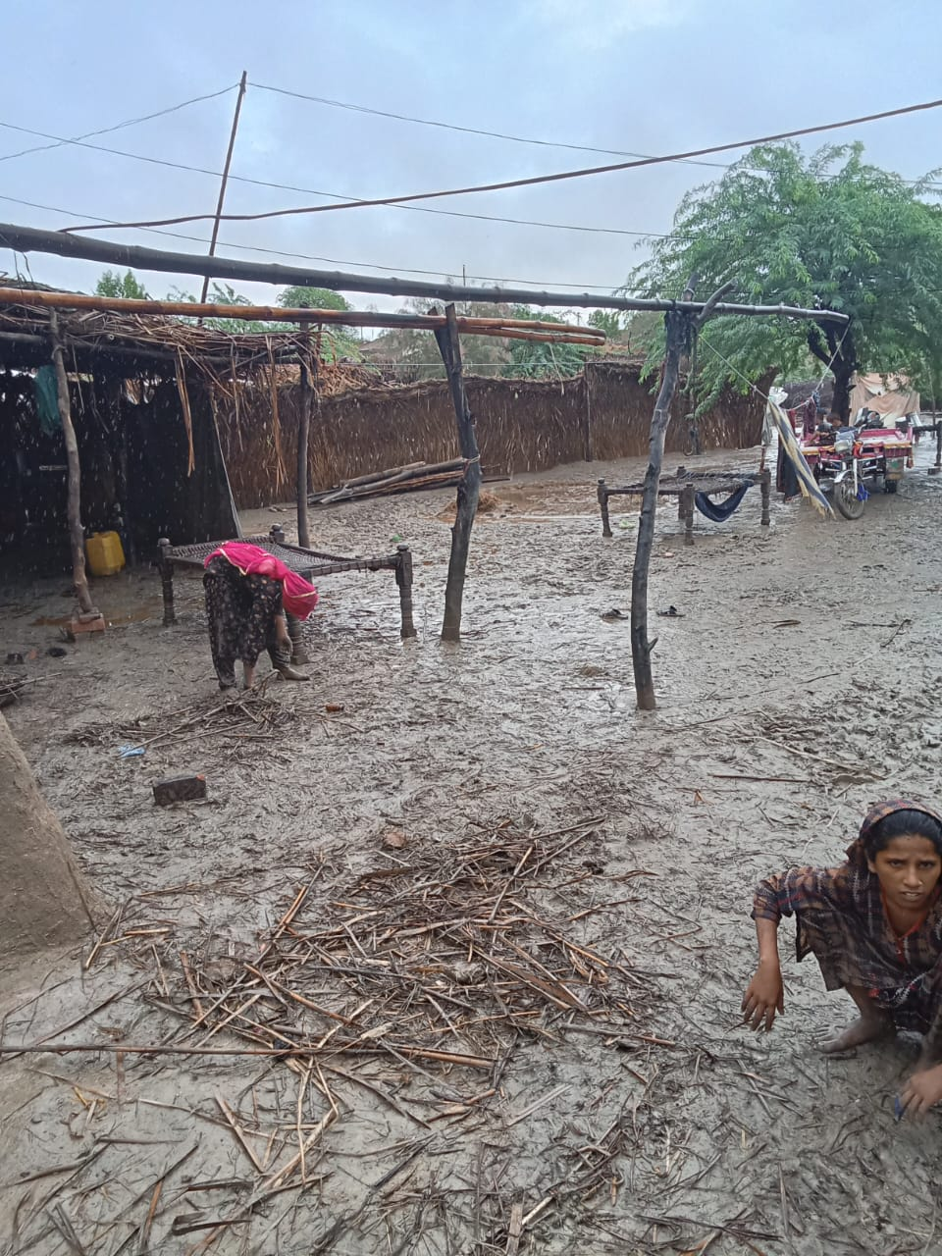
Images

Slide 19
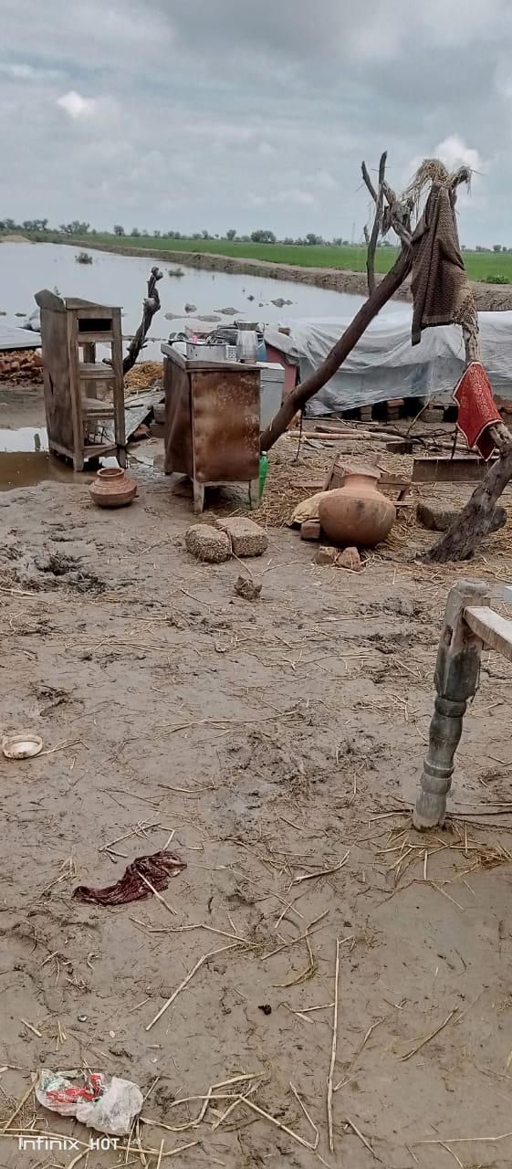
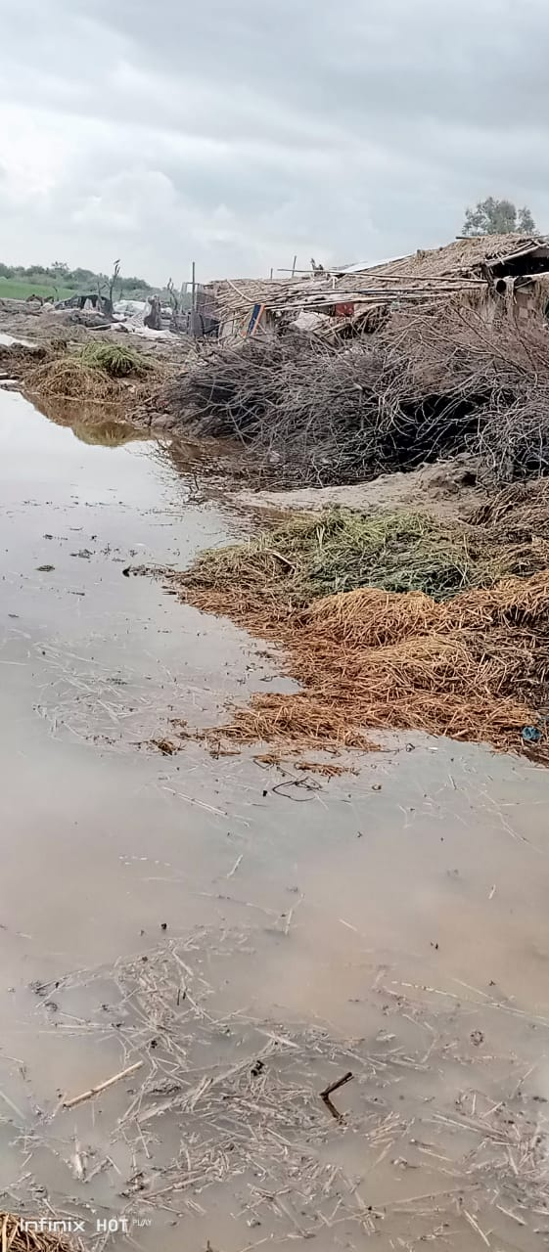
Images

Slide 20
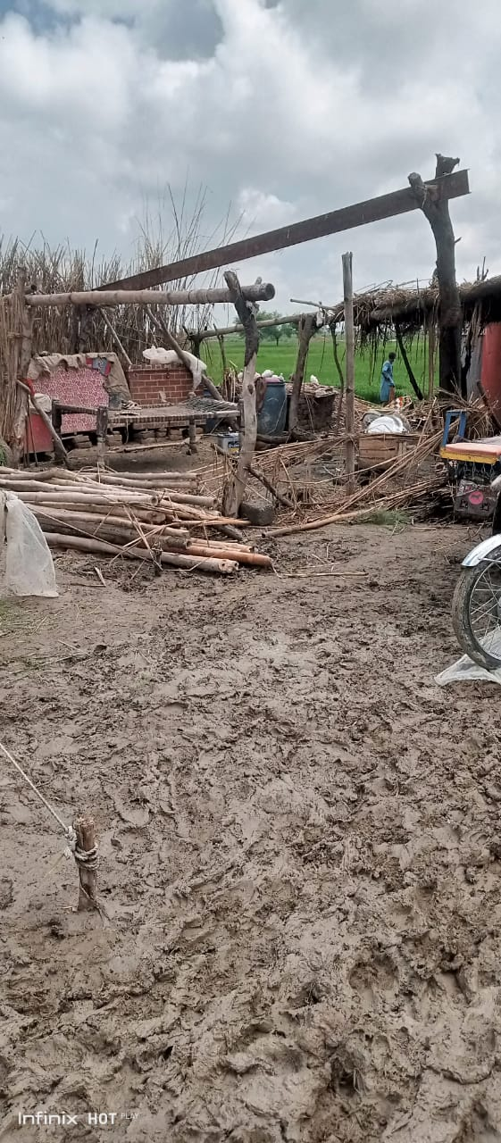
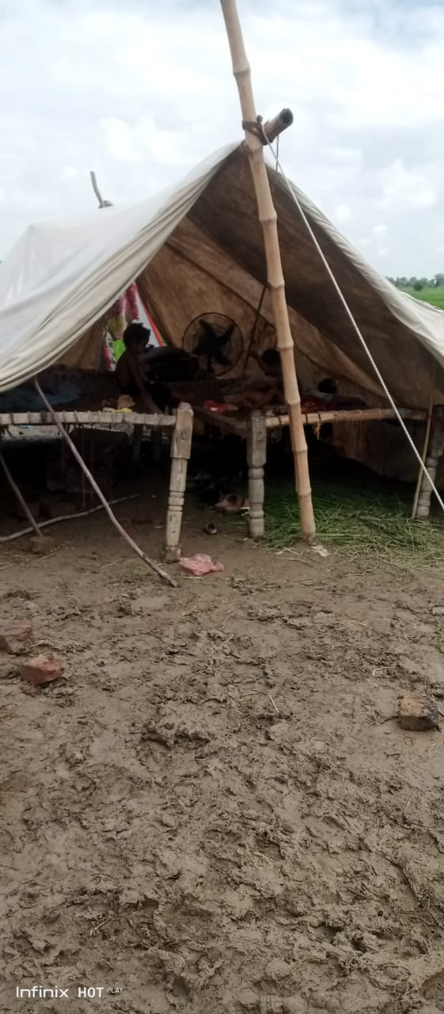
Images

Slide 21
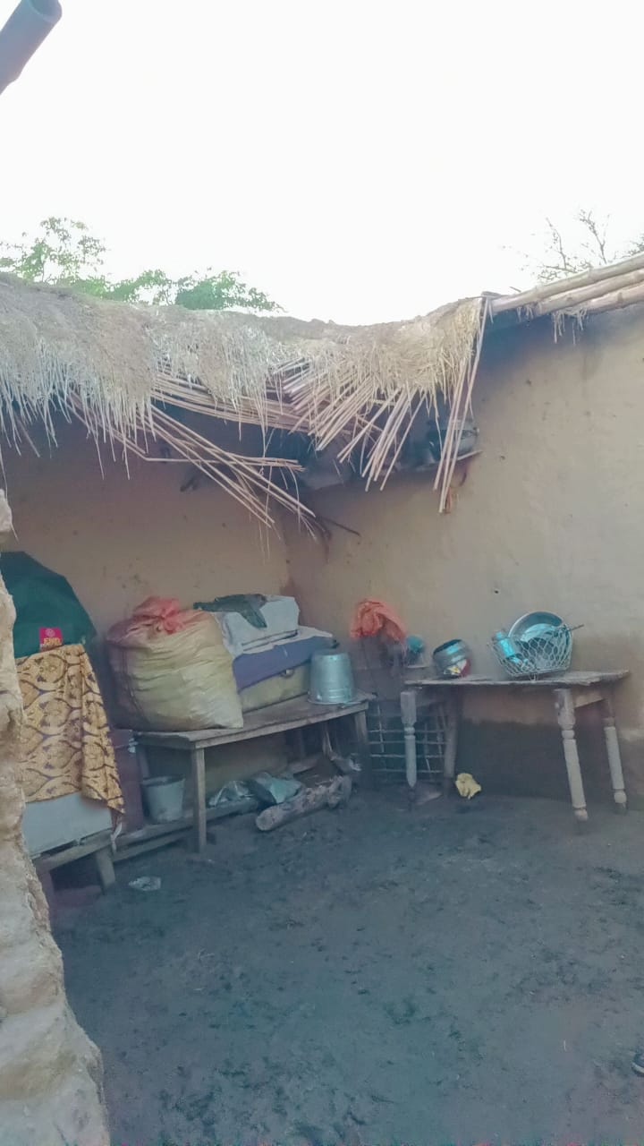
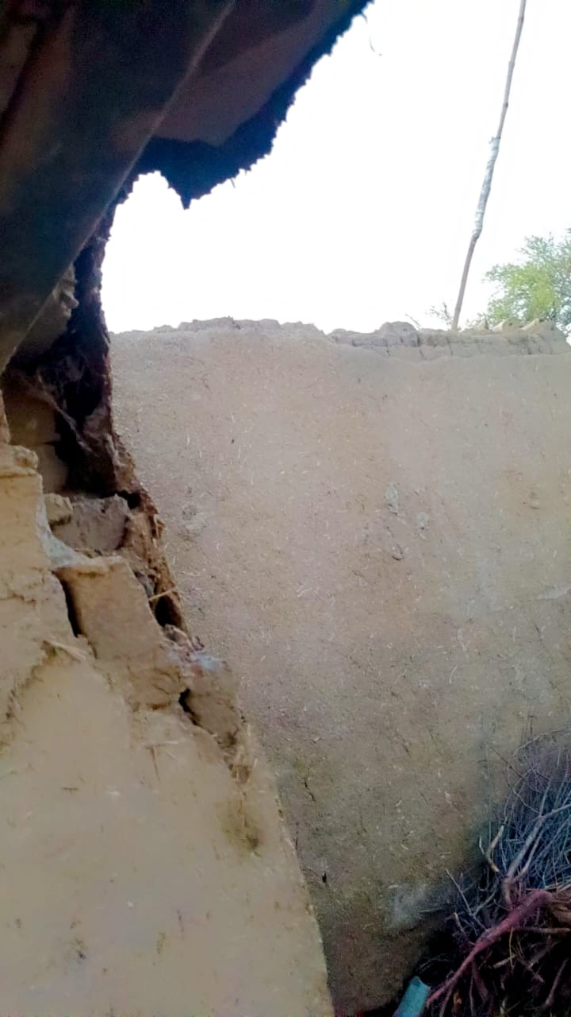
Images

Slide 22
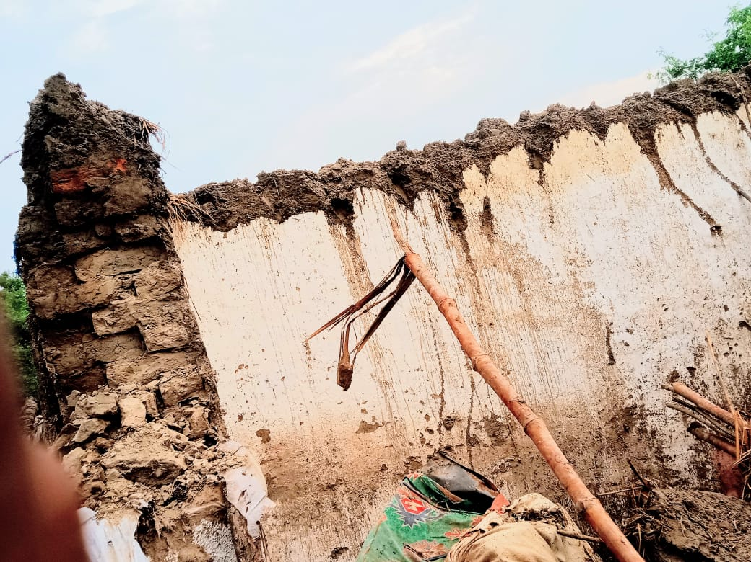
Images

Slide 23
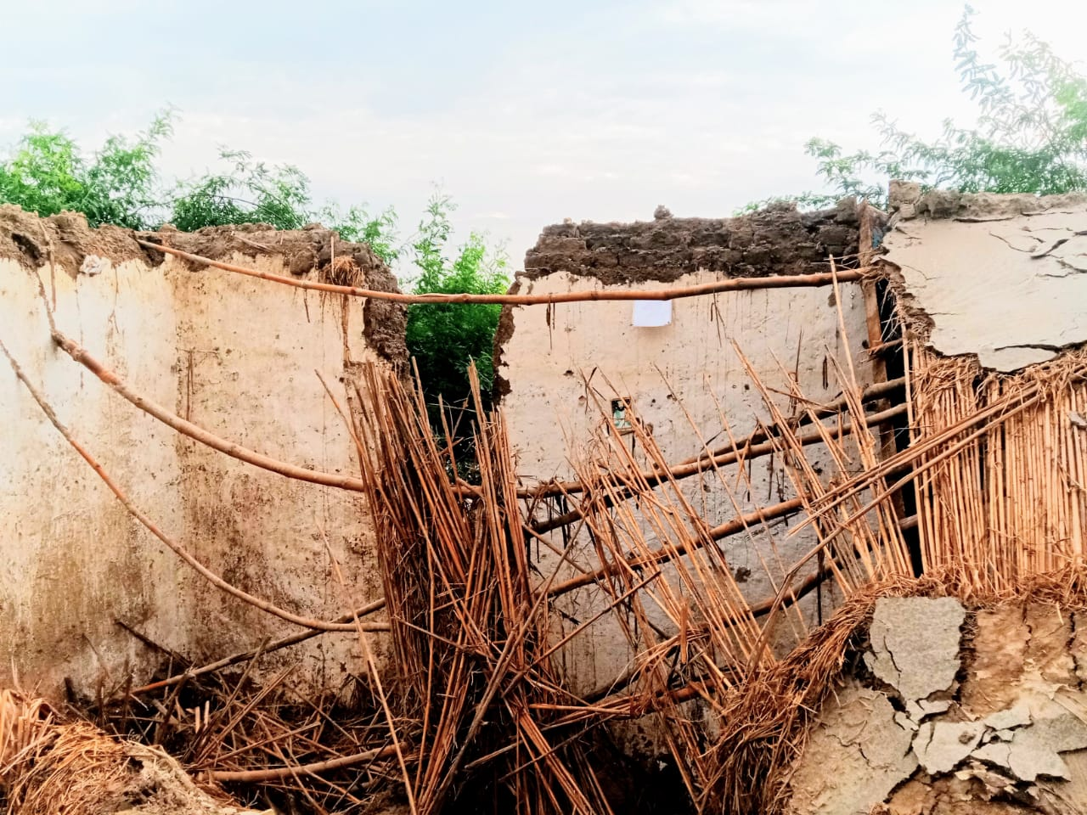
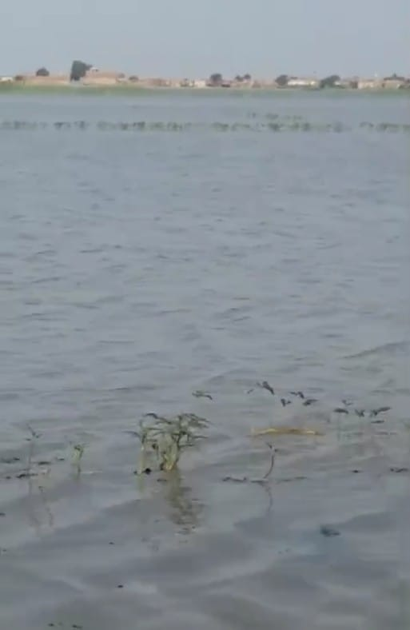
Images

Slide 24
Images

Slide 25
Images

Slide 26
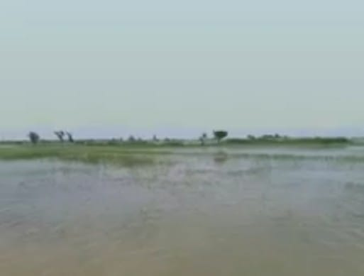
Images

Slide 27
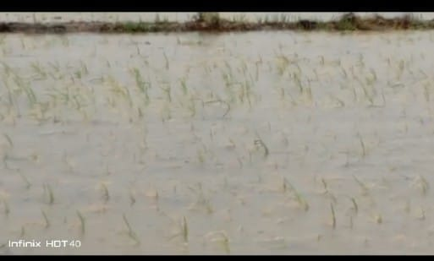
Images

Slide 28
THANK YOU

