Slide 1
Khyber Pakhtunkhwa Monsoon 2023 Updates (17th July To Till Date)
24th July 2023

Slide 2
Agenda
Overview
Damages
Response & Relief
Current Roads Situation

Slide 3
Agenda
Overview
Damages
Response & Relief
Current Roads Situation

Slide 4
Overview
Districts of Chitral Upper & Lower in particular and Districts Dir Upper & Lower experienced increased torrential rainfall w/e from 17th July to 23rd July, 2023
As a result, parts of Upper Chitral were disconnected from rest of Khyber Pakhtunkhwa at (Kari & Koghuzi) and from Gilgit Baltistan at (Shahidas) due to washed away of RCC Bridges, leaving 170,000 (approx.) population stranded
Earlier PDMA has issued a series of advisories dated (11th July, 17th July, 19th July & 21st July) copies attached cautioning the relevant District Administration and population concerned to adopt safety measures before and during the inclement weather.

Slide 5
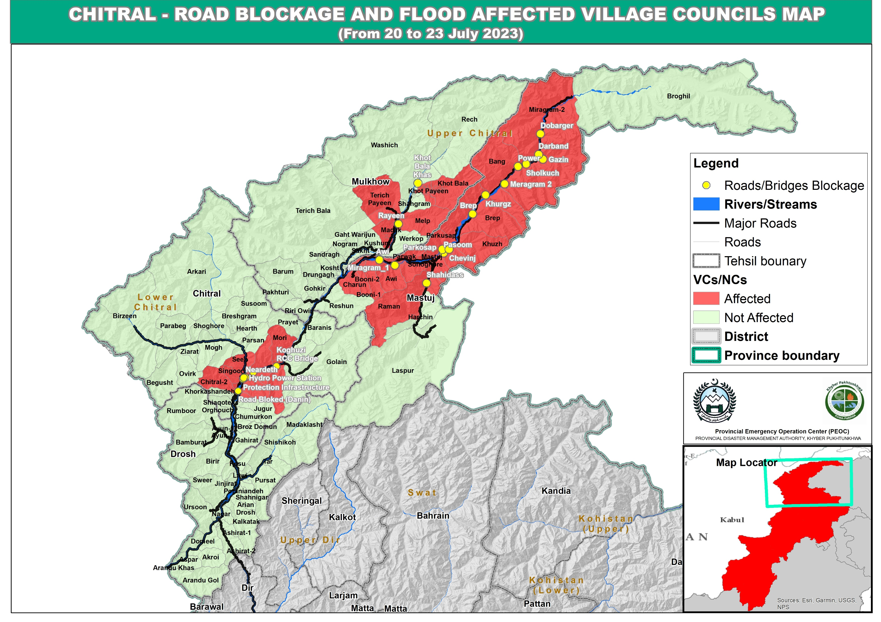
Overview

Slide 6
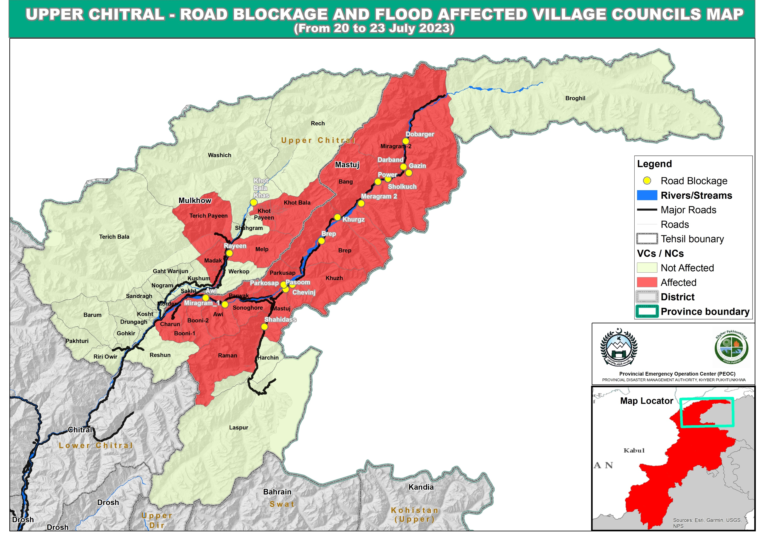
Overview

Slide 7
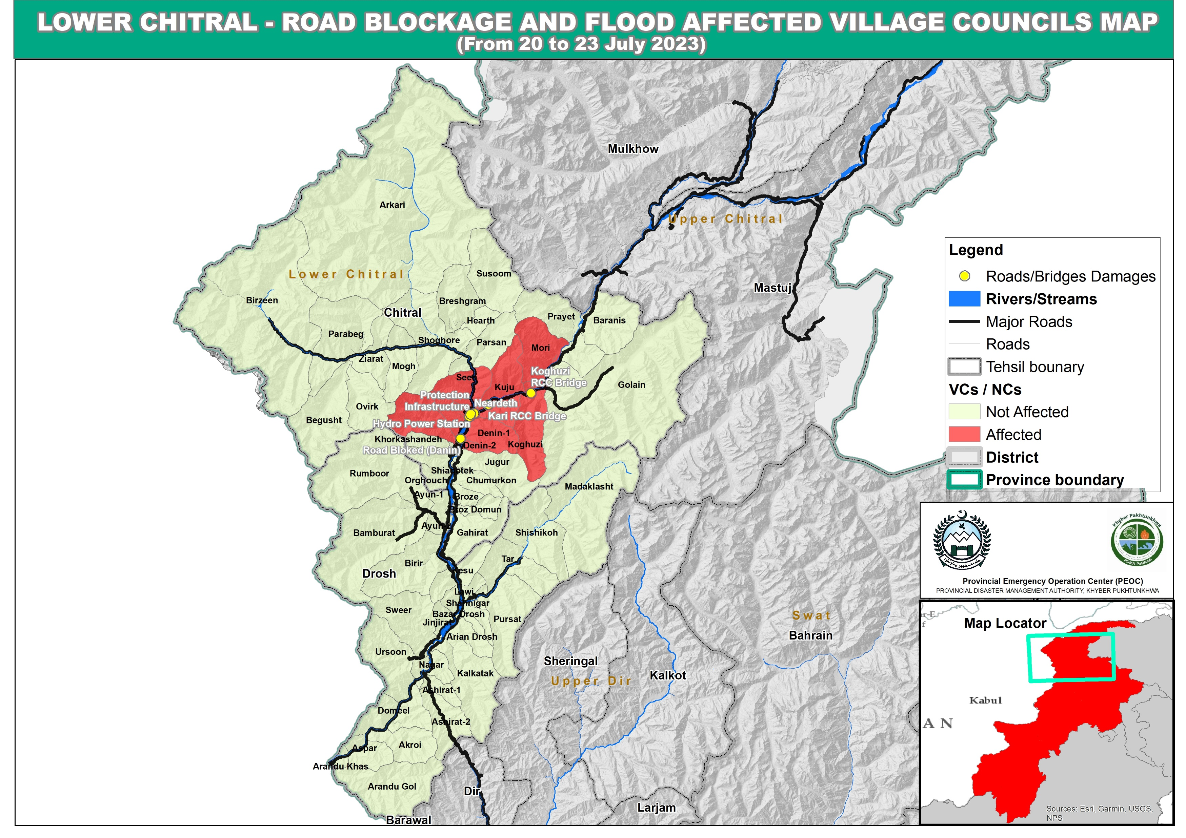
Overview

Slide 8
Agenda
Overview
Damages
Response & Relief
Current Roads Situation

Slide 9
Damages Overview
Human Deaths | 11
Human Injuries | 10
Displaced Persons | 120 Families Affected
Houses Fully Damaged | 17
Houses Partially Damaged | 103
Cattles perished | 50
Bridges | 05
Schools | 02
Drinking Water Supply Schemes | 32
Shops Damages | 13
Power House Damages | 01

Slide 10
District Wise Damages to Human Settlements
District | Deaths | Injured | Cattle Perished | Total Damaged Houses
Chitral Lower | 0 | 0 | 0 | 25
Chitral Upper | 0 | 0 | 47 | 65
Swat | 2 | 3 | 0 | 2
Battagram | 2 | 3 | 0 | 1
Mansehra | 4 | 1 | 0 | 10
Karak | 0 | 2 | 0 | 1
Kohistan Upper | 0 | 1 | 0 | 0
Dir Upper | 1 | 0 | 0 | 0
Shangla | 1 | 0 | 0 | 4
Buner | 1 | 0 | 0 | 3
Mardan | 0 | 0 | 2 | 1
Abbottabad | 0 | 0 | 0 | 3
Malakand | 0 | 0 | 1 | 3
Bajaur | 0 | 0 | 0 | 2
Total | 11 | 10 | 50 | 120

Slide 11
Damages to Bridges
S# | District | No of Bridges Affected | Area
1 | Chitral Lower | 02 | Booni Road at Kari RCC Bridge & Koghuzi RCC Bridge
2 | Chitral Upper | 01 | Shahidas Nullah
3 | Dir Lower | 01 | Shamsi Khan, Talash
4 | Swat | 01 | Chinar Baba (Pedestrian Bridge)
 | Total | 05

Slide 12
Water/ Drinking Water Supply Scheme (Chitral Lower)
Occurrences of flood date | Area | Water Supply | Status | Present Status
19-07-2023 | Arandu | 1 | PHED | Temporarily restoration will be made subject to accessibility to the affected areas within 3-5 days.
22-07-2023 | Gahrait | 1 | PHED
22-07-2023 | Ayun | 1 | PHED
22-07-2023 | Ayun Sahan Payeen | 1 | PHED
22-07-2023 | Ramboor | 1 | PHED
22-07-2023 | Bamborait | 1 | PHED
22-07-2023 | Bakamak | 1 | PHED
22-07-2023 | Uchusht Balasar | 1 | PHED
22-07-2023 | Balach | 1 | PHED
22-07-2023 | Faiz Abad Hone , Faiz Abad Ph-1, Mustajapandeh | 3 | PHED
22-07-2023 | Danin | 1 | PHED
22-07-2023 | Danin Lasht | 1 | PHED
22-07-2023 | Jugoor (Dawashish , Hinju gole , Shoot ) | 1 | PHED
22-07-2023 | Chitral City | 1 | PHED
22-07-2023 | Uc Kuh | 1 | -do-
22-07-2023 | Thingshan | 1 | -do-
22-07-2023 | Golain Payeen Bakha and Chashma | 1 | -do-
Position on 31st August 2022 10 PM

Slide 13
Water/ Drinking Water Supply Scheme (Chitral Upper)
Date | Area | Water Supply | Status | Present Status
20/07/2023 | Shahidas | 1 | NGO Scheme | Water Supply to all the projects would temporarily be restored within 2-3 days after the availability access to the area and source position
20/07/2023 | Parwak | 1 | PHED
20/07/2023 | Awi | 1 | PHED
22/07/2023 | Miragram-I | 1 | PHED
22/07/2023 | Gazeen Yarkhun | 1 | NGO Scheme
22/07/2023 | Brep | 2 | PHED
22/07/2023 | Zhupu | 1 | NGO Scheme
22/07/2023 | Nishku | 1 | PHED
22/07/2023 | Madak | 1 | PHED
17/07/2023 | Dhumadumi | 1 | NGO Scheme
22/07/2023 | Werkup | 1 | PHED
22/07/2023 | Booni 3 | 1 | PHED

Slide 14
Agenda
Overview
Damages
Response & Relief
Current Roads Situation

Slide 15
Response & Relief Measures (1/2)
Upon requests received from Deputy Commissioner Chitral Upper And Lower, Emergency has been declared till 15th of August in both the districts.(Copy annexed)
Sum of rupees 20 Million each has been released to district Chitral upper and lower and another 10 Million each to district Shangla and Bannu.
Relief items (NFIs & FIs) have been provided to the affectees
The vulnerable communities have been evacuated to safer places
Machineries Deployed for Early Restoration of Roads
Provincial Emergency Center of PDMA is operational 24/7 and active coordination with all line departments is established.
All Deputy Commissioners have been directed to immediately pay off the compensation checks to the death and injured as per the revised compensation policy 2023. (Copy attached).
Rescue 1122 Activities
151 persons were rescued in Flood Affected Areas (Denin, Nerdad Gol, Kari, Ayun, Singoor, Khor Kahsan) in Chitral Lower
102 vehicles were saved from Flood Water at Denin
Drain out water from Power House Singoor and saved important items
Clear the roads from Chew Bridge
Media Dissemination
Warning broadcasts through print & electronic media
Coordination with all Relevant Stakeholders
Information sharing regarding Damages/ Losses & Relief Activities

Slide 16
Response & Relief Measures (2/2)
NFIs Dispatched to Chitral Upper
NFIs Dispatched to Chitral Lower
Tents | 150
Plastic Mats | 100
Kitchen sets | 150
Buckets | 100
Quilts | 100
Mattresses | 150
Tarpaulin | 150
Hygiene Kits | 150
Solar Lights | 150
Jerry Cans | 100
Mosquito Nets | 100
Soaps | 400
Ropes | 25
Pillow | 200
Wheel Chair | 05
Stretchers | 05
De-Watering Pumps | 02
Prayer Mats | 50
Sand Bags | 400
UNHCR Tents | 100
Sand Bags | 5000
Search Light | 200
Kitchen Sets | 500
Common Tents | 100

Slide 17
Agenda
Overview
Damages
Response & Relief
Current Roads Situation

Slide 18
Current Road Situation (Chitral Upper)
Brep alternate restored, Parkusep Road, Parwak Road and Rayeen to Kot Road are opened at the moment in Upper Chitral. The below given Roads are still blocked: -
Yarkhoon Road at Shanogol, Chuinj Bala, Pasum Gol
Booni to Mastuj Main Bridge side walls damaged and Road is closed.
Shahidas Road
Booni Sonoghur Road
Nichagh Road at Gazeen
Yarkhoon Road at Shalkoach.
Khot Road
Restoration work is in progress on the above mentioned areas

Slide 19
Current Road Situation (Chitral Lower)
Kaghuzi Bridge work completed and Road is open.
Danin N45 Road cleared for traffic.
Nerdait Nullah Kari Bridge one side diversion completed.
Debris clearance completed on km35 Morai, Chitral Booni Road.
Road levelling and clearance is in progress N45 Bardam area
Restoration work is in progress on Danin Gahtak road.
Work is in progress on Madaklasht road at patigal
Golain Road machinery mobilized by Golain Gol Authorities for road clearance.
Work in progress on Asrait N45 Road.
Garam Chashma Road
Clearance work is in progress on Main Mastuj Road to upper Chitral

Slide 20
Road Situation in Swat & Battagram
Swat:
Main road of Chamtalai Khwazakhela has been partially damaged. (Restoration work is in progress)
Battagram:
The following roads are blocked due to a landslide:
1. Main Sachbyar Road.
2. Thakot Banna Road.
Restoration work is in progress

Slide 21
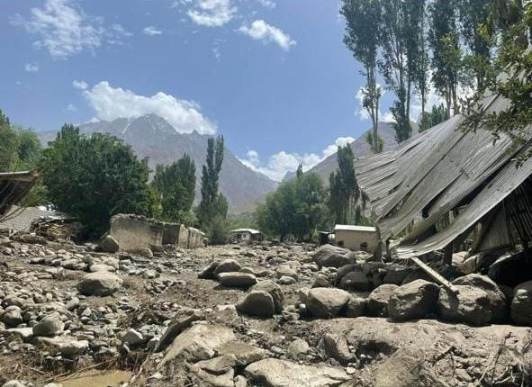
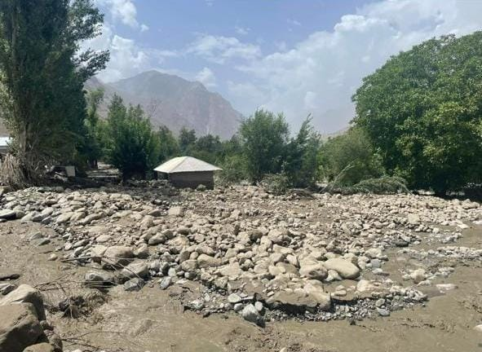
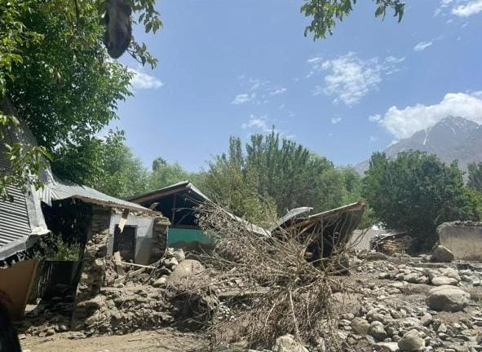
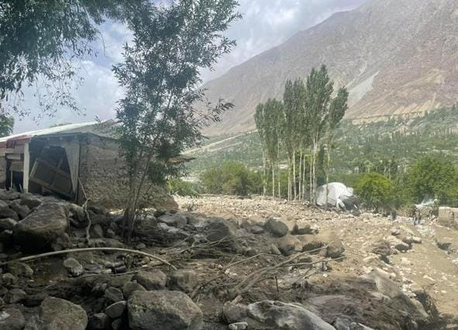
Pictorial View

Slide 22
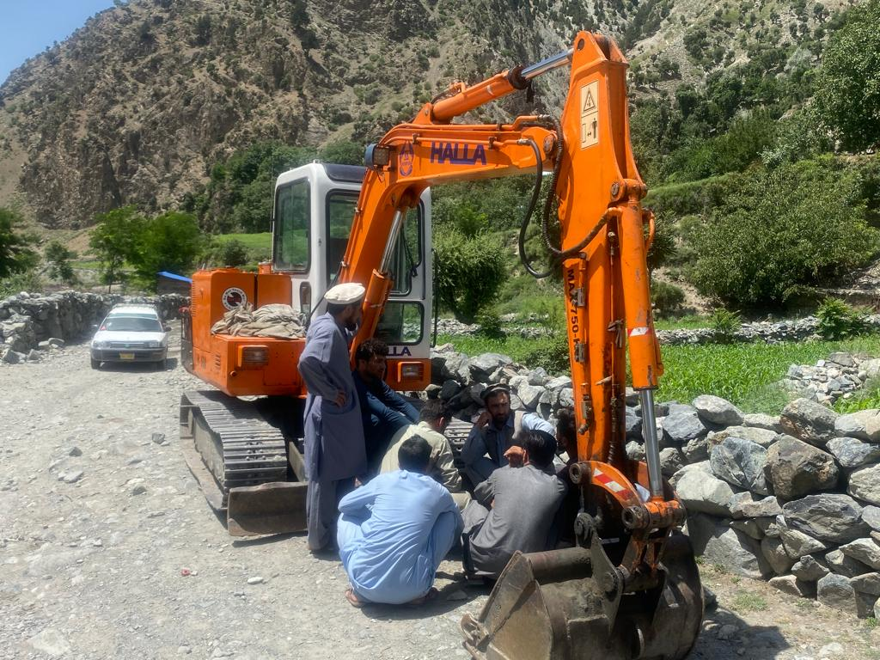
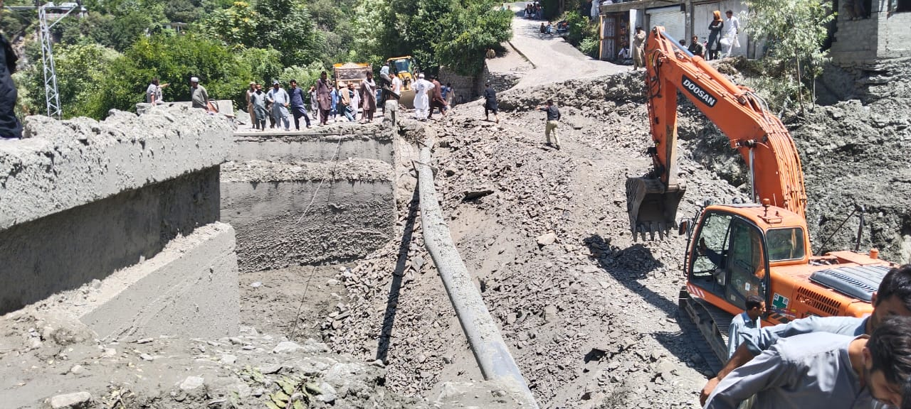
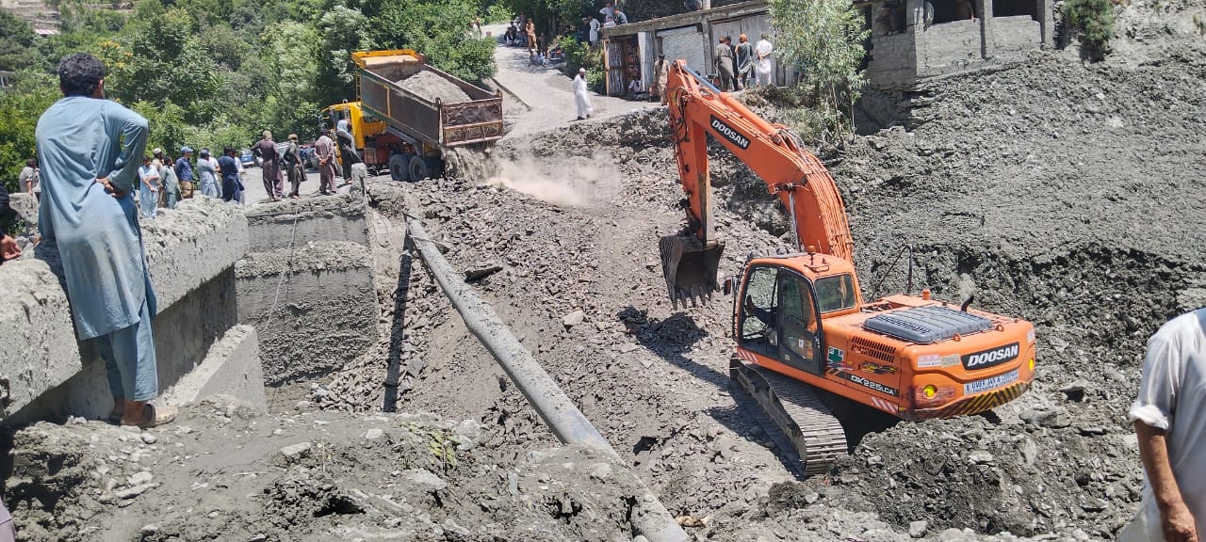
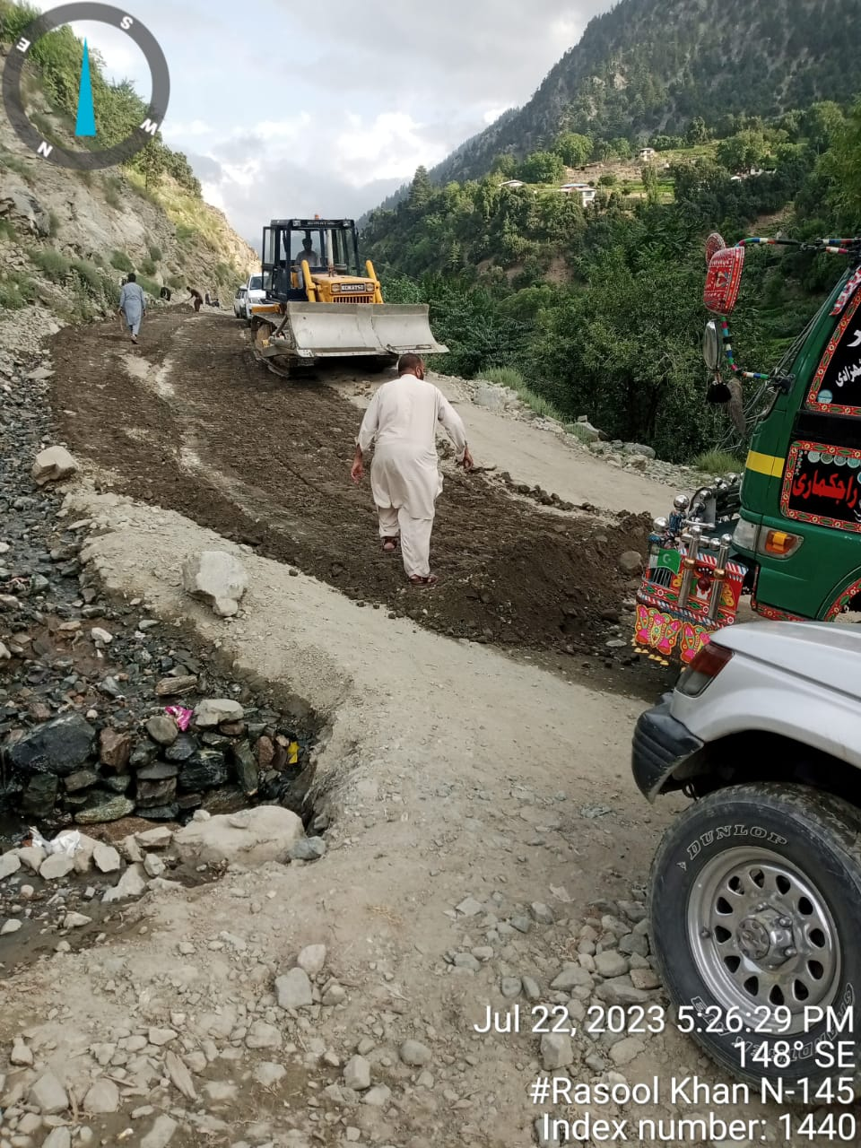
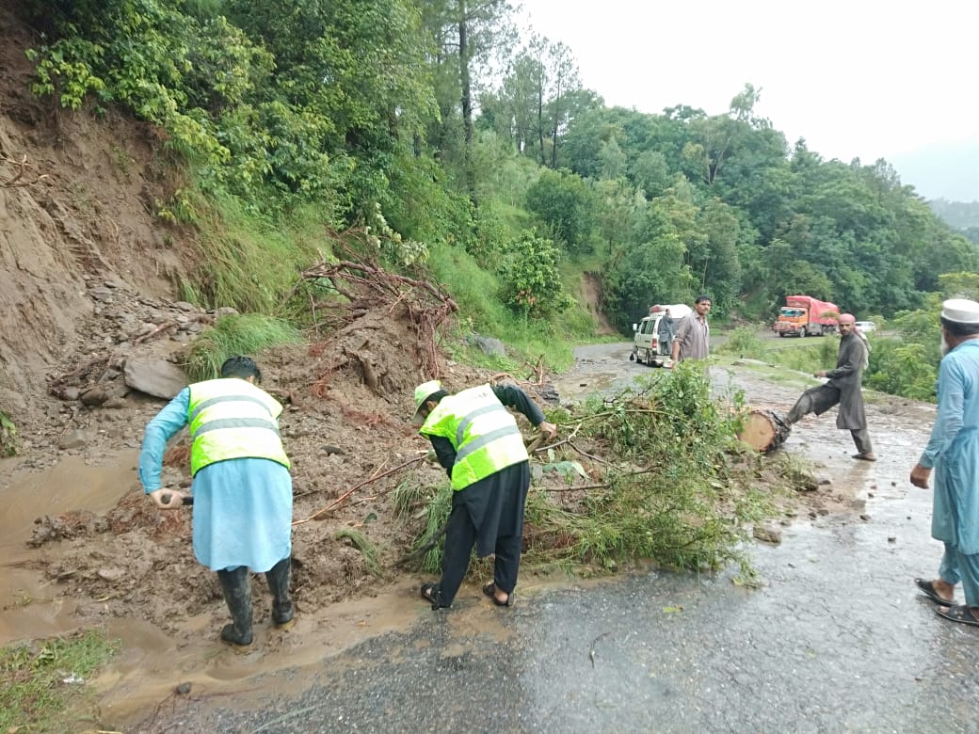
Pictorial View

Slide 23
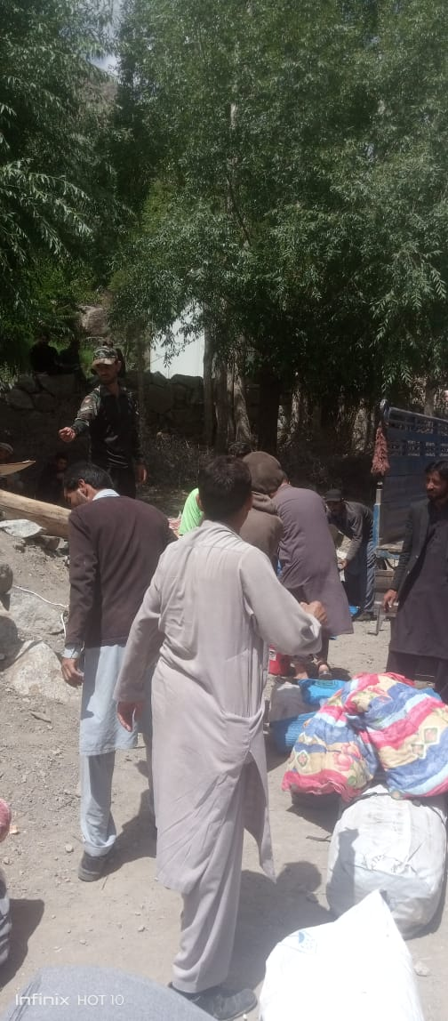
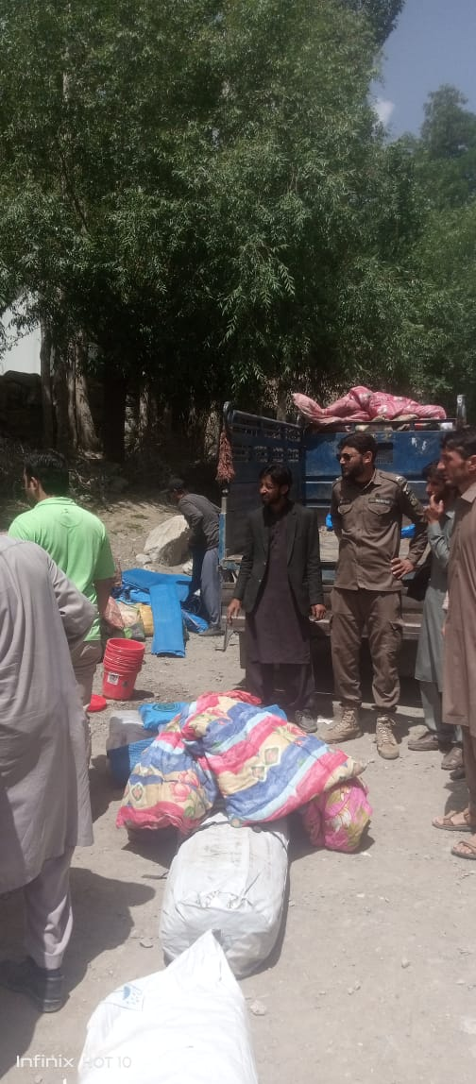
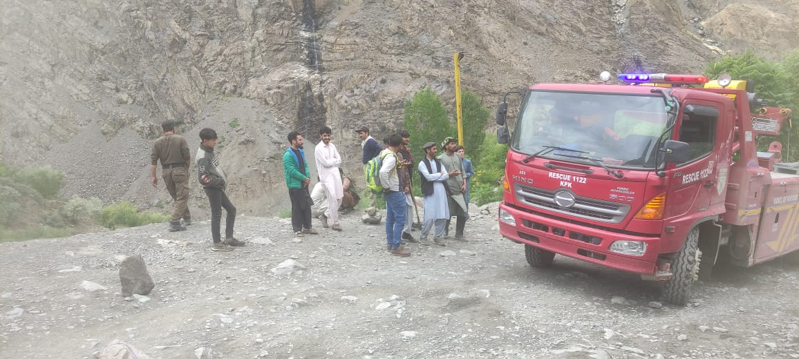
Pictorial View

Slide 24
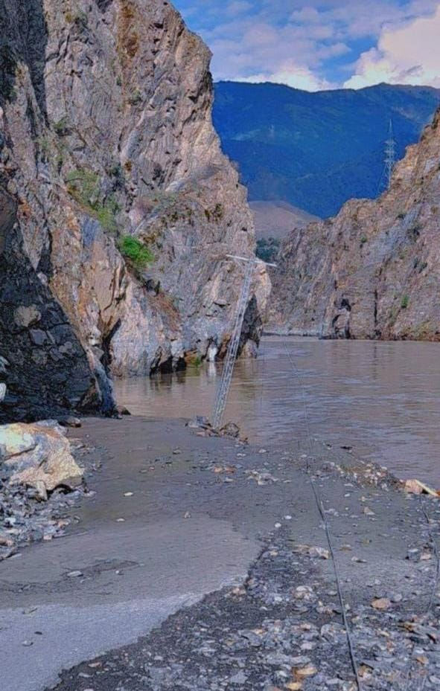
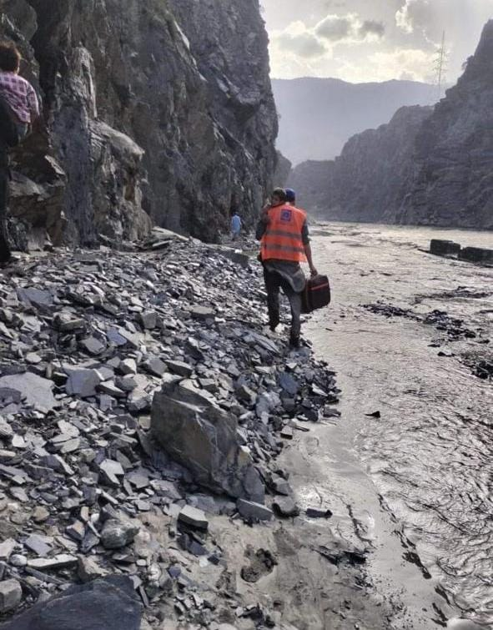
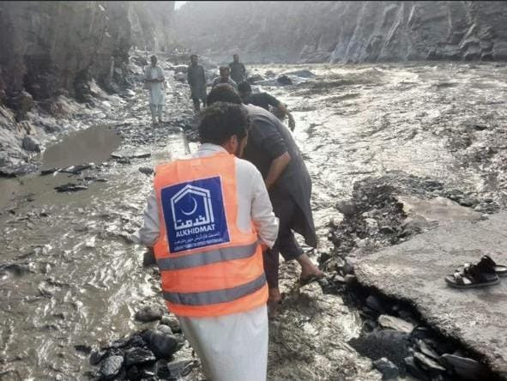
Pictorial View

Slide 25
Thanks

Slide 26
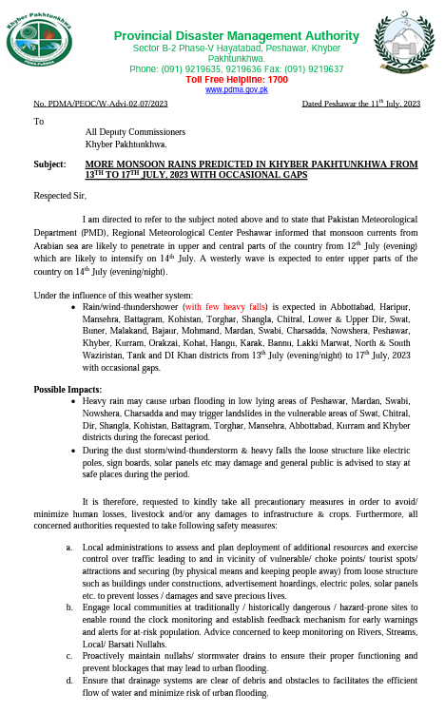
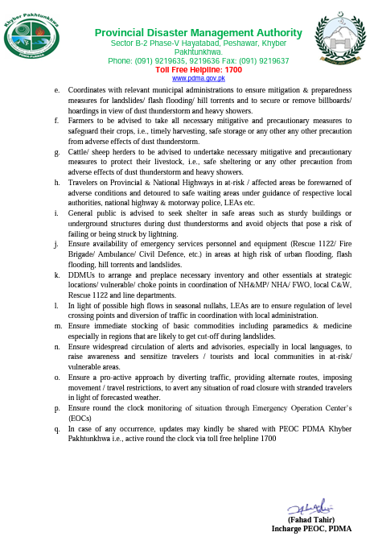
PDMA Advisory (11th July)
Back

Slide 27
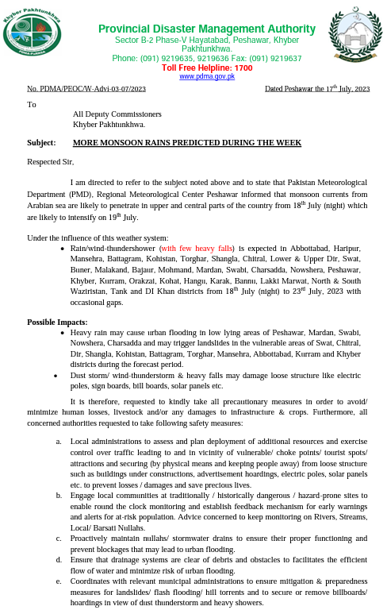
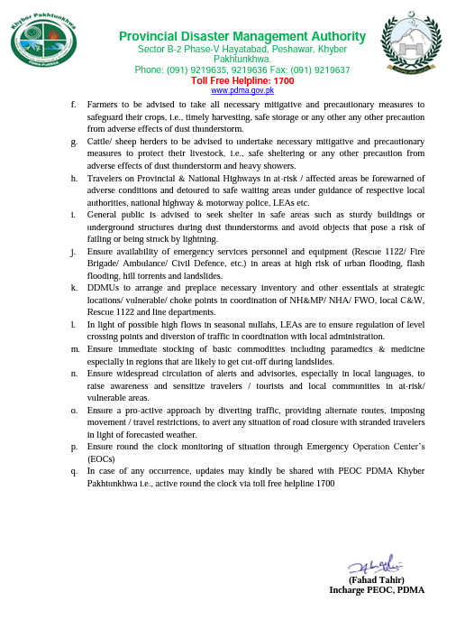
PDMA Advisory (17th July)
Back

Slide 28
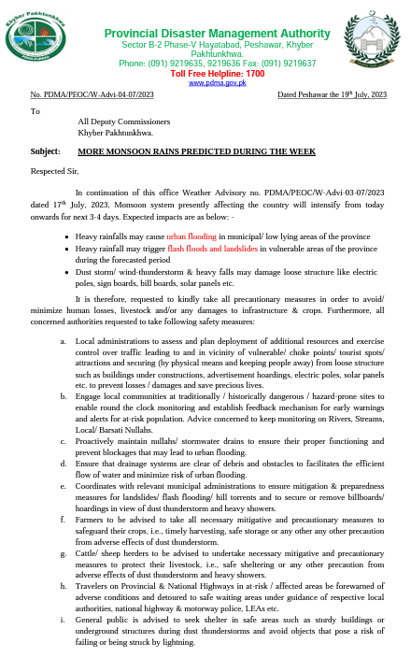
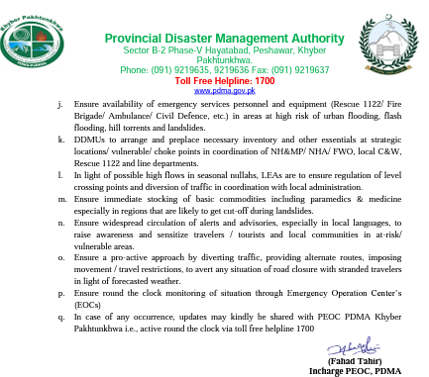
PDMA Advisory (19th July)
Back

Slide 29
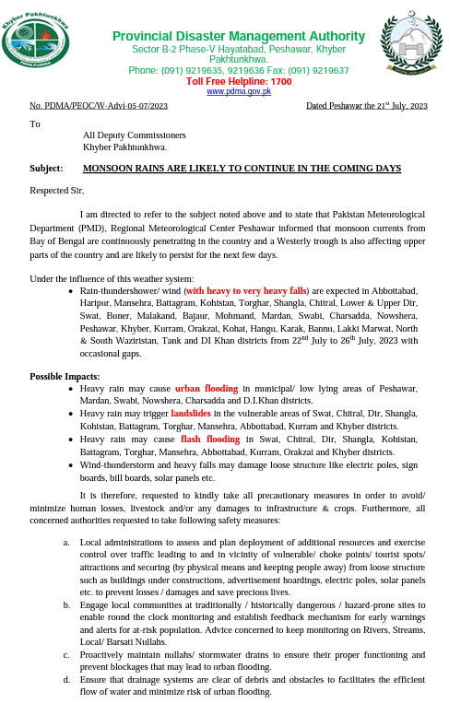
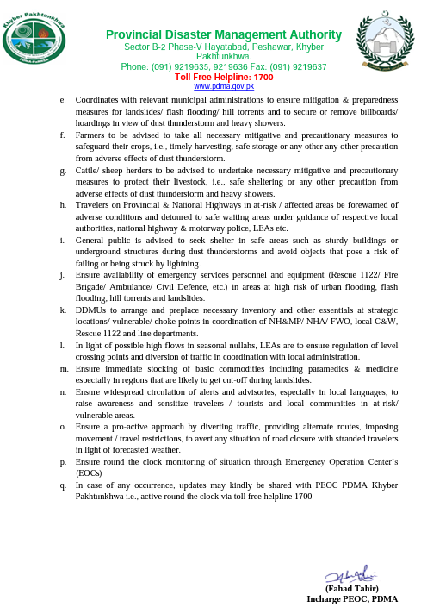
PDMA Advisory (21st July)
Back

Slide 30
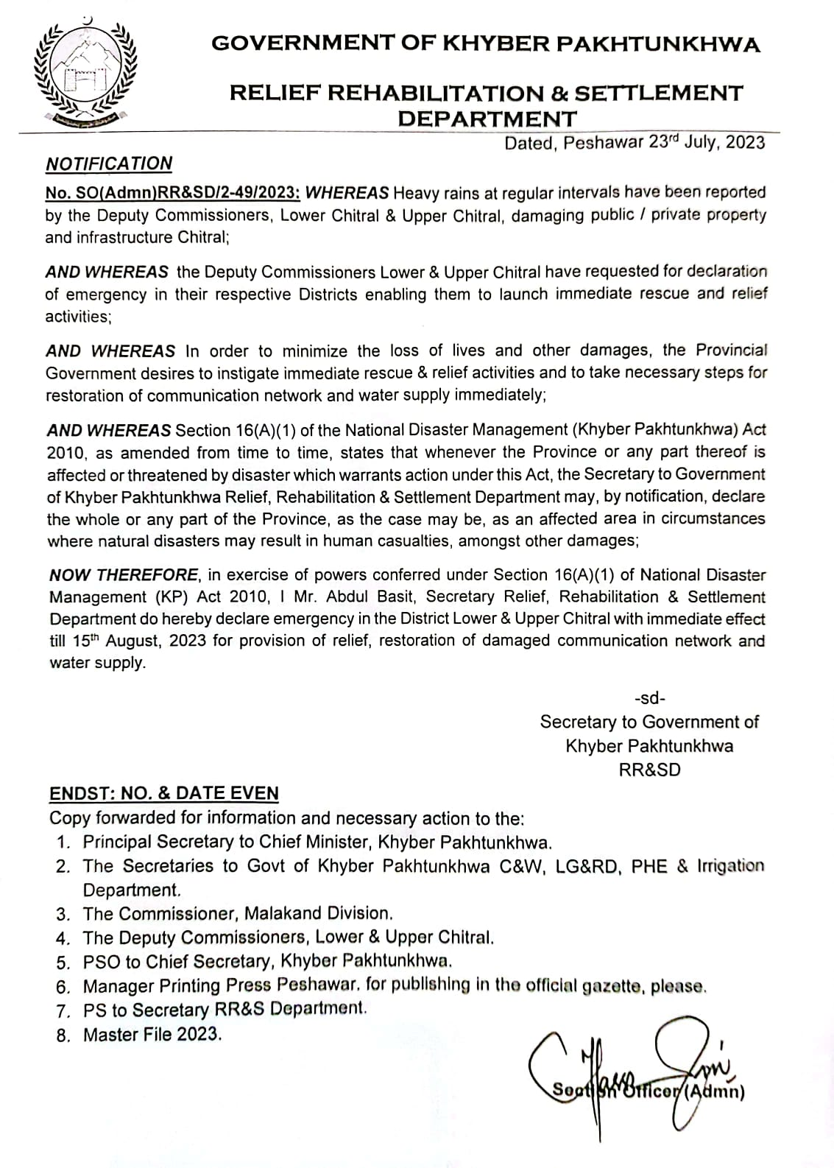
Emergency Notification in District Chitral (Lower & Upper)
Back

Slide 31
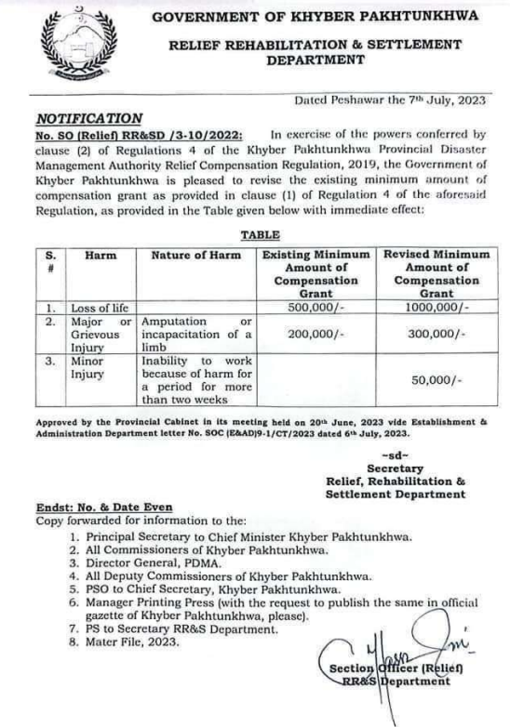
PDMA Revised Compensation Policy 2023
Back

