Slide 1
Recovery Response, Lessons Learnt
By: Adeel Javaid
Shelter Technical Advisor-CRS
Dated: 15-Nov-2022

Slide 2
Prevalent Construction Typologies
Typology | Prevalence | Damages | Replication
Mud Houses | High | High | High
Adobe Block Houses | Low | Moderate to Low | Low
Burnt Brick Houses | Low | Low | Low
Concrete Brick Houses | Low | Moderate | Low
Loh-Kath Houses | Low | Moderate | Low
Chora Houses | Low | Moderate | Particular Areas
Makeshift | Low | N/A | Self Recovery

Slide 3
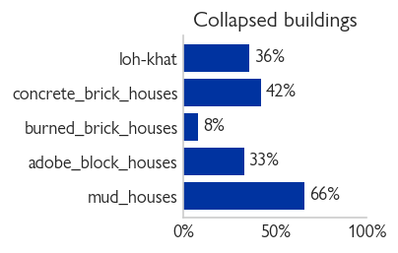
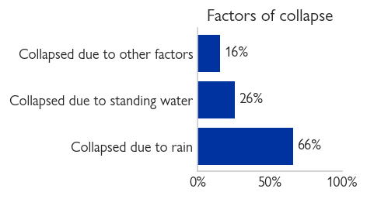

Slide 4
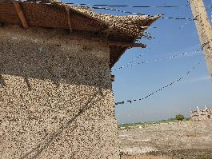
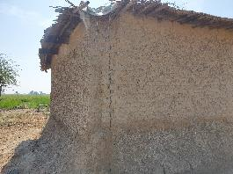
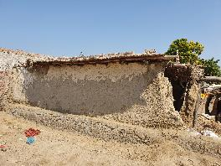
Potential Failures
Disintegration of mud plaster
Weak Eave (shed) corners and absence of gutters resulted in roof collapse and also the damages to corners
Improper mud mix – process of lime stabilization and community behaviors
Salinity and lime stabilization
Kath termite infestation
Mud/adobe wall with compromised width

Slide 5
Insight
Less information on the government reconstruction plans and echo of cash based owner Driven reconstruction.
Few organizations/actors started implementing but less sharing and exchange of ideas
Risk associated to households inclusions in the government plans (if any)
Different construction modalities have already been adopted. Risk of households provided with a housing option that do not suit their cultural and utility preferences
Communities have started repairing their houses, makeshift shelters, burnt brick columns and repair of walls and roofing structure.
Funding situation is meager and needs on the ground are way to high.

Slide 6
DRR/Raised platform

Slide 7
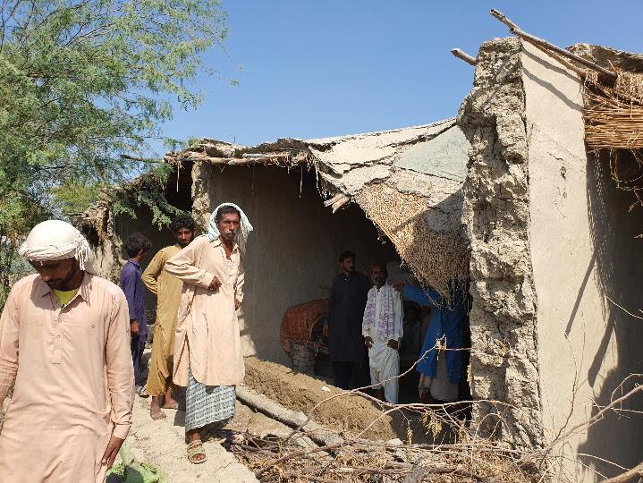
Self Recovery is Ongoing

Slide 8
Self Recovery is Ongoing

Slide 9
Self Recovery is Ongoing

Slide 10
Lessons Learnt
10 to 12 years after – a landscape to understand that how different typologies behaved, results of different processes/approaches adopted and general replicability.
Multiple housing assistance in 2010-12 and disparity in housing assistance
Modalities adopted – Owner Driven, In-Kind and Conditional Cash Modalities
Extensive trainings vs replicability
Involvement of masons as change agent and technical resource person instead of a “skilled labor”
Investment on most prevalent typologies

Slide 11
Construction Material
Construction material for different prevalent typologies is available in the local market
Use of hay in burnt bricks and potential of shortage
Risk of price surge in future and increased cost of construction
Incident of conflicts over collection of panna leaves as it is being used in makeshift shelters

Slide 12
Way forward
Multiple unknowns, (particularly around Government plans and beneficiary choices)
Coordination and coherence:
Need of Shelter sector strategy. Work closely for intelligence gathering to shape up the sector strategy.
Team up to draft socio-technical messages. Value beneficiary choice of typology and develop relevant technical material.
Though Markets are functional and there is potential of conditional cash and Owner Driven approach. Need for sector to carryout a collective market assessment, respective challenges and solutions
Support Government initiatives with potential scope around mason involvements in the project, beneficiary orientations on financial disbursement and key technical messages, increased compliances and role of door to door technical assistance. IEC and mode of communications.
Incremental solutions (Value of money): Communities have already started rebuilding and need financial and technical support. Reach maximum households with affordable incremental solutions.
Challenges around lime stabilization and potential adaptable solutions.
Brainstorming on the processes and need of Homes and Community approaches.
Challenges to vulnerable households and need to share best practices to target vulnerable households.

Slide 13
Thank You!
By: Adeel Javaid
Shelter Technical Advisor-CRS
Dated: 15-Nov-2022

