Slide 1

Pakistan Shelter Sector
National Shelter Sector Meeting
07 December 2022 | Islamabad

Slide 2
Shelter/NFI Sector Working Group
07.12.2022 Agenda
Welcome and Introduction (5Minutes)
Sector Updates ( 5 Minutes)
Sector response data - 5Ws data and gap analysis (10 Minutes)
Feed back on Winterization strategy (10 Minutes)
ORS Survey updates (10 Minutes)
PDNA updates (5 Minutes)
DTM updates ( 5 Minutes)
AOB (10 Minutes)

Slide 3
Shelter Working Group Updates
SWG activate at National and Provincial level.
Bi-weekly meetings held at national and Provincial level.
Sindh government conducted a comprehensive joint survey of flood affected areas from September 26 to November,2022 for assessment of damages to life, property and crops at village level by District administration, NDMA, PDMA and army personnel.
90% Survey has completed, report will be polished till 15 December,2022.
Priority: Advocacy for coverage gaps; use vulnerability criteria for selection of beneficiaries. More engagement from local authorities needed.
Priority: Ensure participation of shelter partners in sector meetings at national and Provincial level.

Slide 4
Challenges
5Ws data of OCHA not covering information at village level so unable to verify duplication.
Identification of gaps, and most vulnerable communities in need of assistance .
Dewatering activities are increasing vulnerabilities of communities living in adjacent areas because there is no natural or artificial source of drainage present/available
Turn over of district officials >> difficult to liaise with administration
Good coverage of Emergency Shelter projects in Shikarpur ,Qambershadadkot and Dadu , more support needed in Shaheed Banazirabad, Mirpurkhas and Noshehroferoz.
Slow progress on provision of emergency shelters in those areas which are not accessible/ under water to protect from upcoming winter.
Early recover shelter activities in Dadu , Jamshoro, Matyari , Jacobabad , Ghotki , Mirpurkhas and Sanghar has started, some did not inform the working group , UN OCHA and authorities.
Recovery shelter committed very low in number ,still not reported by implementing partners.

Slide 5
5W reporting
Two report process – pipeline or non pipeline
5W data quality:
  Ongoing activities
  What is a distribution?
  People reached
  Why getting the reporting right is important
Notes:
A third of 5W entries are ongoing – doesn’t make sense in the emergency phase
One row is one distribution
Planned activities can’t have people reached
If you don’t report correctly you wont appear in the gap analysis - duplication

Slide 6

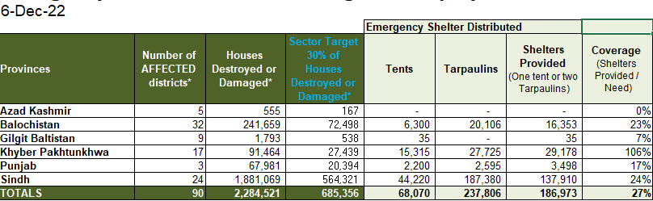

Slide 7
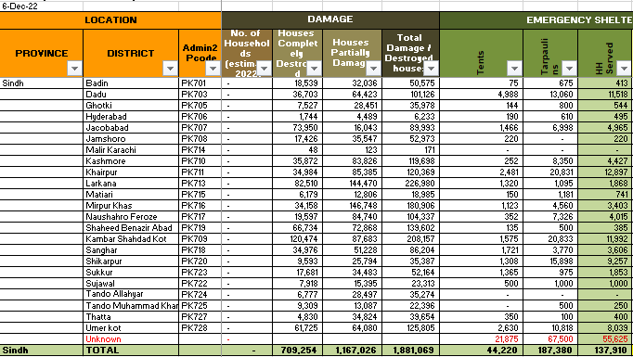

Slide 8


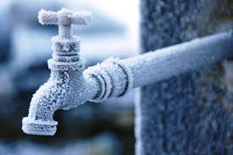


Slide 9
SHELTER PRIORITIES FOR WINTERIZATION
There is an urgent need for winterization as part of the response to the Pakistan floods, as extreme weather in certain affected areas may further endanger lives. Shelter and NFI support are a priority in order to protect flood-affected households from the elements.
This Strategy advocates for an immediate response to these needs and provides recommendations on minimum winterization standards.
As winter has arrived in most of the affected areas the timeframe for action is extremely limited.
Districts in northern KP, Gilgit Baltistan and some areas of Baluchistan will face sub-zero temperatures in the coming months

Slide 11
To maximize assistance and protection for those in need, the Winterization Strategy for Shelter & NFI advocates that the following three approaches be undertaken simultaneously:
Accelerated and increased distribution of winterized emergency shelter & NFI .
Provision of winterized Transitional Shelter .
Identification of alternative solutions including collective centers.

Slide 12
SHELTER Sector RECOMMENDED NFI KIT FOR FLOODS RESPONSE 2022

Slide 14
2022 Winterized Shelter Technical Guidelines
A winterized tent must be made of waterproof canvas and must have a strong supporting frame. It must provide a minimum of 12m2 (130sq.ft.) covered area. Additionally, a winterized tent has the following components:
Fly sheet :Separate fly sheet, usually made from canvas, which fits over the inner tent.
Flue manifold: The inner tent and flysheet each have a metal plate with a hole in it. These plates are sewn in or fixed into a canvas pocket. This allows for a stove with a chimney to be placed inside the tent without the risk of the flue pipe igniting the canvas when hot.
Structural supports: The poles which form the vertical supports, and the ridge beam should be made of a thick gauge steel (min 1.5mm) and with an external diameter of 35-50mm. This gives suitable structural resistance to both high winds and snow loading.
Inner lining: The inner tent may have a light cotton (‘desouti’) lining.
Mud flaps / valences: The tent must have rot proof mud flaps of suitable quality and length to allow the tent to be dug into the ground.

Slide 15
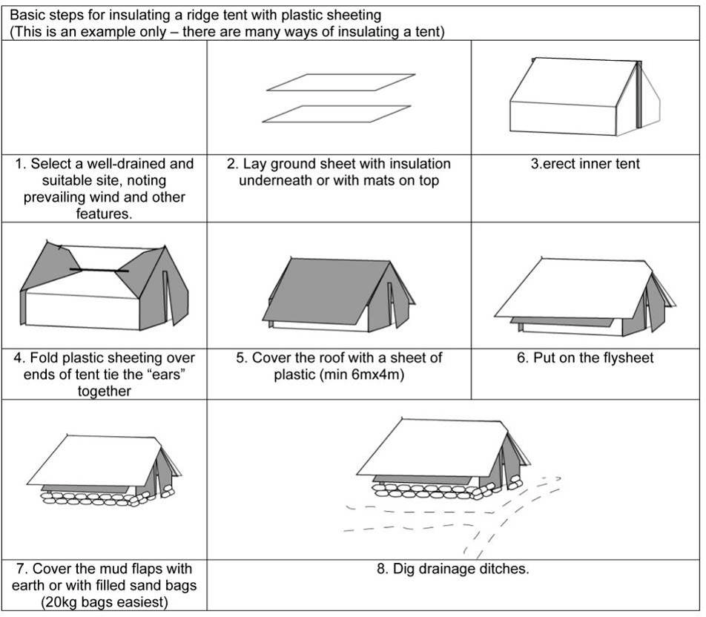

Slide 16
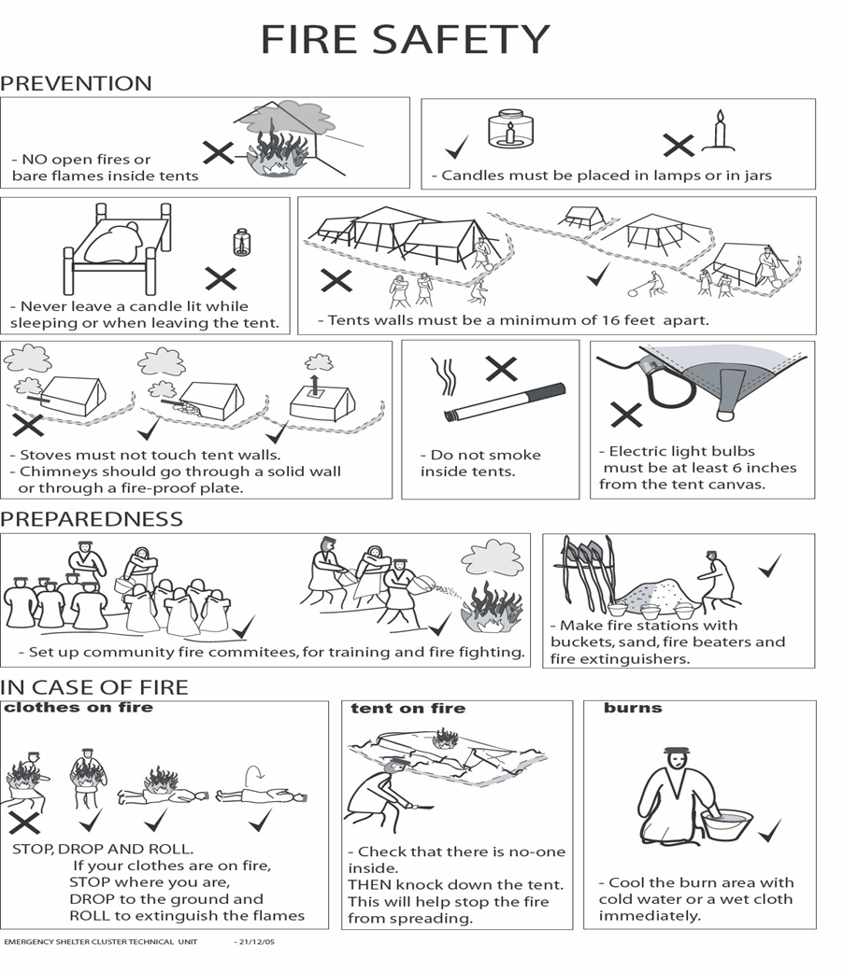
Fire Safety recommendations for temporary settlements

Slide 17
ORS Survey Updates
This analysis is based on assessments of a sample of 372 villages in Sindh in which One Room Shelters were built in 2012 and 2013.
The survey was conducted in following districts of Sindh:
South Sindh:
Mirpurkhas , Umerkot, Tharparkar , Badin ,Tando Allah Yar and Tando Muhammad Khan .
North Sindh:
Shikarpur , Ghotki , Qamber Shahdadkot and Jacobabad .

Slide 18
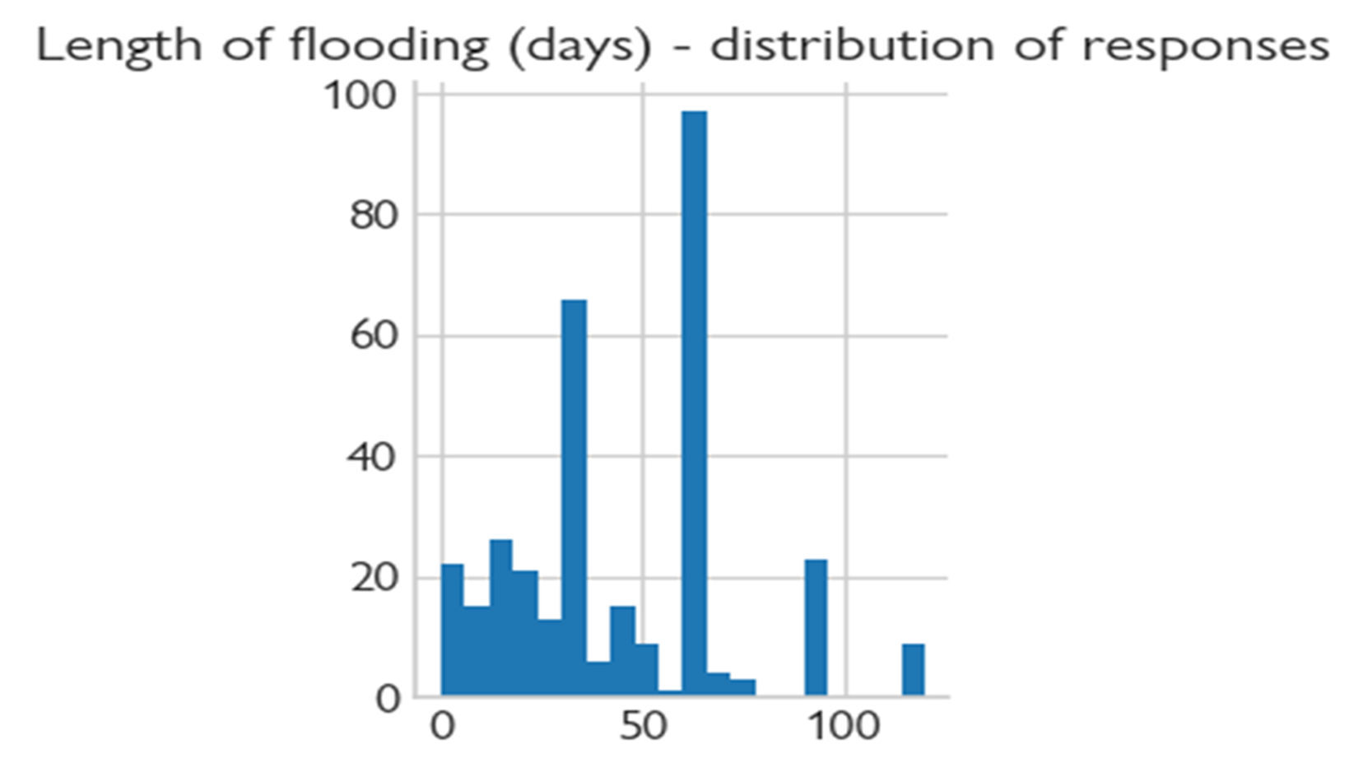
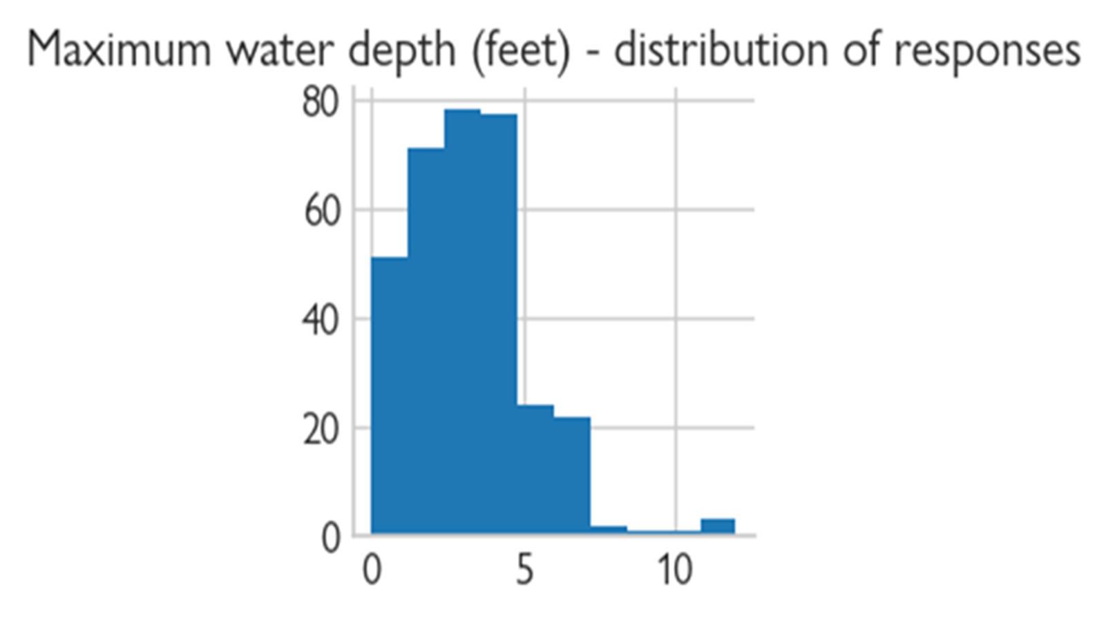
One Room Shelter

Slide 19
Building types and damages | baseline | collapsed | percent collapsed
Mud_houses | 35,225 | 23,279 | 66%
Adobe_block_ houses | 6,966 | 2,310 | 33%
Burned_brick_ houses | 16,470 | 1,272 | 8%
Concrete_brick_ houses | 778 | 327 | 42%
Loh-khat | 14,587 | 5,248 | 36%

Slide 20
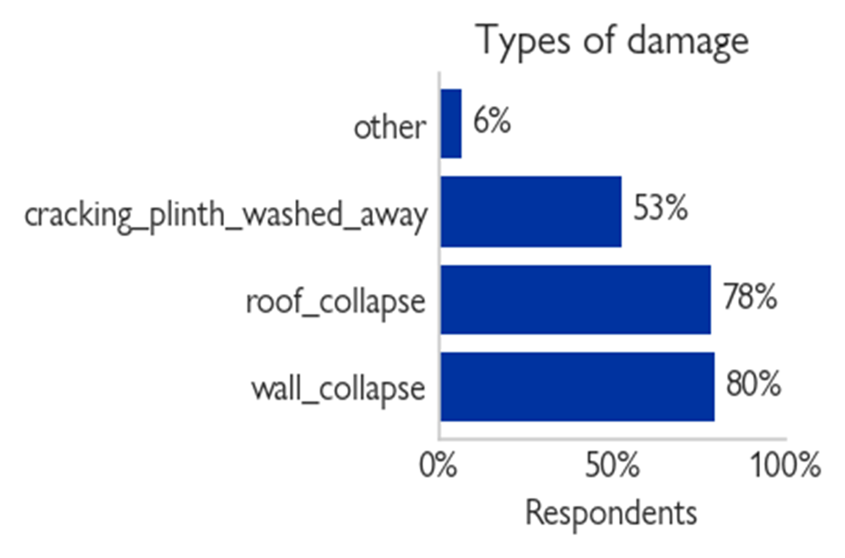
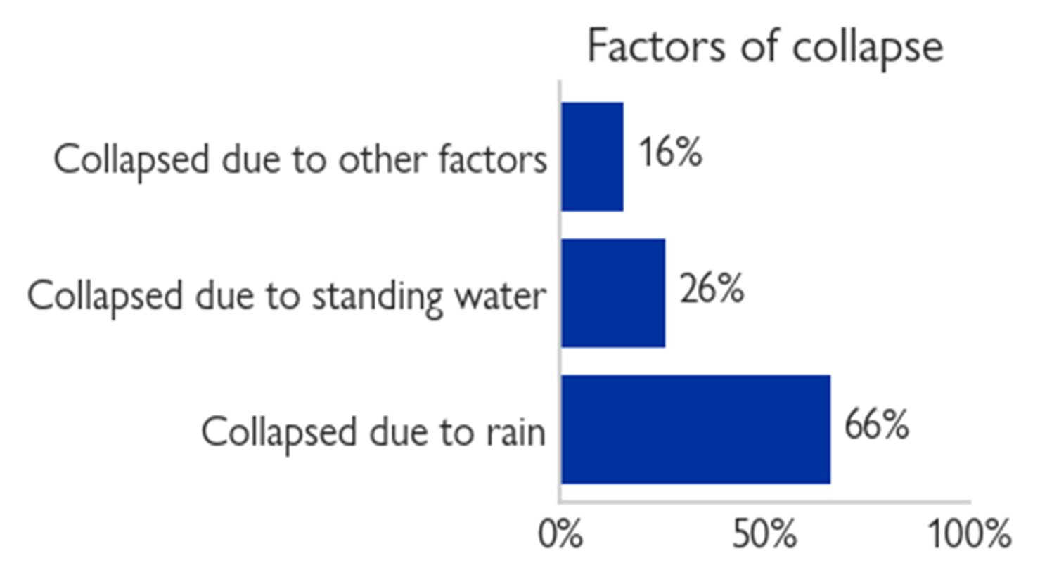
One Room Shelter

Slide 21
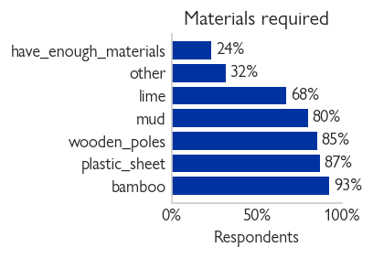

Slide 22
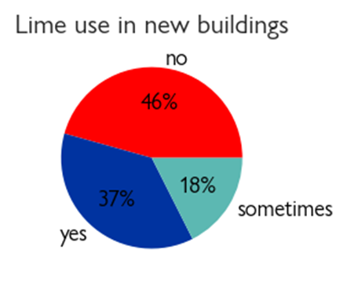
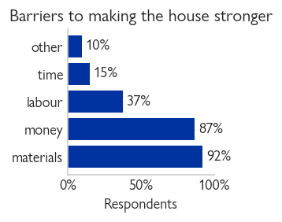
Building practices, knowledge and barriers

Slide 23
PDNA Updates
The Pakistan Post-Disaster Needs Assessment (PDNA) assesses the impact of the 2022 floods on the Country’s population, physical assets, and service delivery. Led by the Government of Pakistan and supported by the Asian Development Bank, the European Union (EU), the United Nations (UN), and the World Bank, the PDNA provides an initial estimate of damages, losses, and needs resulting from the disaster in the short-, medium-, and long-term. The PDNA follows a globally established and recognized damage, loss, and needs assessment methodology jointly developed by the EU, the World Bank Group (WBG), and the UN. The PDNA is structured as two reports:
Main Report,
Includes estimates of damage, loss and needs; an overview ofmethodology overview, recovery strategies, macroeconomic and human impacts, and a summary of sector assessments; and the (ii) Supplemental Report, includes full sector assessments, and a full list of contributors and credits

Slide 26
FLOOD RESPONSE BASELINE ASSESSMENT- SINDH PROVINCE (DTM)
NDMA reported up to 33 million people have been affected by the floods since mid June 2022 as of 17 October 2022.
¹ According to the NDMA Daily Situation Report No.126, 24 districts in Sindh province are calamity-hit and an estimated total of 14,563,770
people are affected by the floods.
² Besides that, 1.9 million houses are reported to be damaged in Sindh province alone.
The purpose of the Baseline Assessment is to map out the estimated number of TDPs and returning TDPs at union council level.
Assessment done in top 5 districts were highest displacement in Sindh province.
These districts are Khairpur, Larkana, Dadu, Umer Kot and Mirpurkhas.
The Baseline Assessment was thus carried out across all 289 union councils that exist under these 5 targeted Districts.

Slide 27
DTM identified that there are an estimated total of 1,502,045 TDPs comprising of 231,630 households displaced due to the floods in the top 5 districts in Sindh Province.
Khairpur district witnessed the most displacement(617,850 TDPs).
The second highest displacement was observed in Dadu district with 285,564 TDPs.
Mirpur Khas district hosted 272,402 TDPs.
The districts with the highest number of returning TDPs were Umerkot and Mirpur Khas, with 196,695 returning TDPs (34,519 households) and 188,225 returning TDPs (29,038 households) respectively.

Slide 29
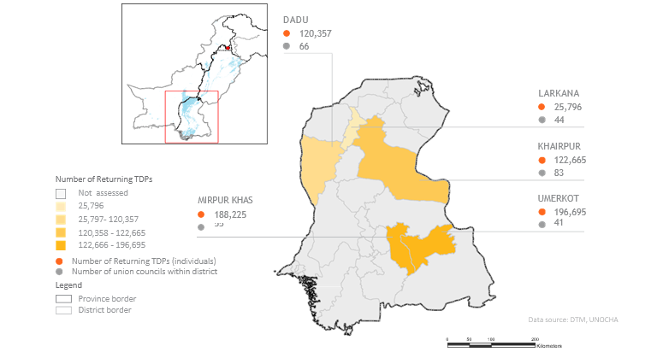
TOP 5 DISTRICTS WITH RETURNS IN SINDH PROVINCE

Slide 30
NUMBER OF UNION COUNCILS THAT REPORTED THE FOLLOWING NEEDS

Slide 31
AoB

